Slide 1
Il contributo tecnologico dell’INFN
S. Gammino
Roma, 6 Dicembre 2013

Slide 2




ESS - General
The ESS will be a multidisciplinary Research center where the most powerful neutron source (30 times more than the today’s leading facilities) will be available
ESS will be constructed in Lund, hosted by Sweden and Denmark but realized by at least 17 European countries
It will be based on a superconducting linear accelerator where high intensity protons will be accelerated
  Average proton beam power: 5MW
  Protons pulse current of 62.5 mA in 2.86 msec at 2.0 GeV
  Repetition rate of 14 Hz
  High reliability (95%) is a challenge for the Front End (under INFN responsibility)
Protons will reach a single neutron target section from which the neutron flux will be produced (spallation reactions)

Slide 3
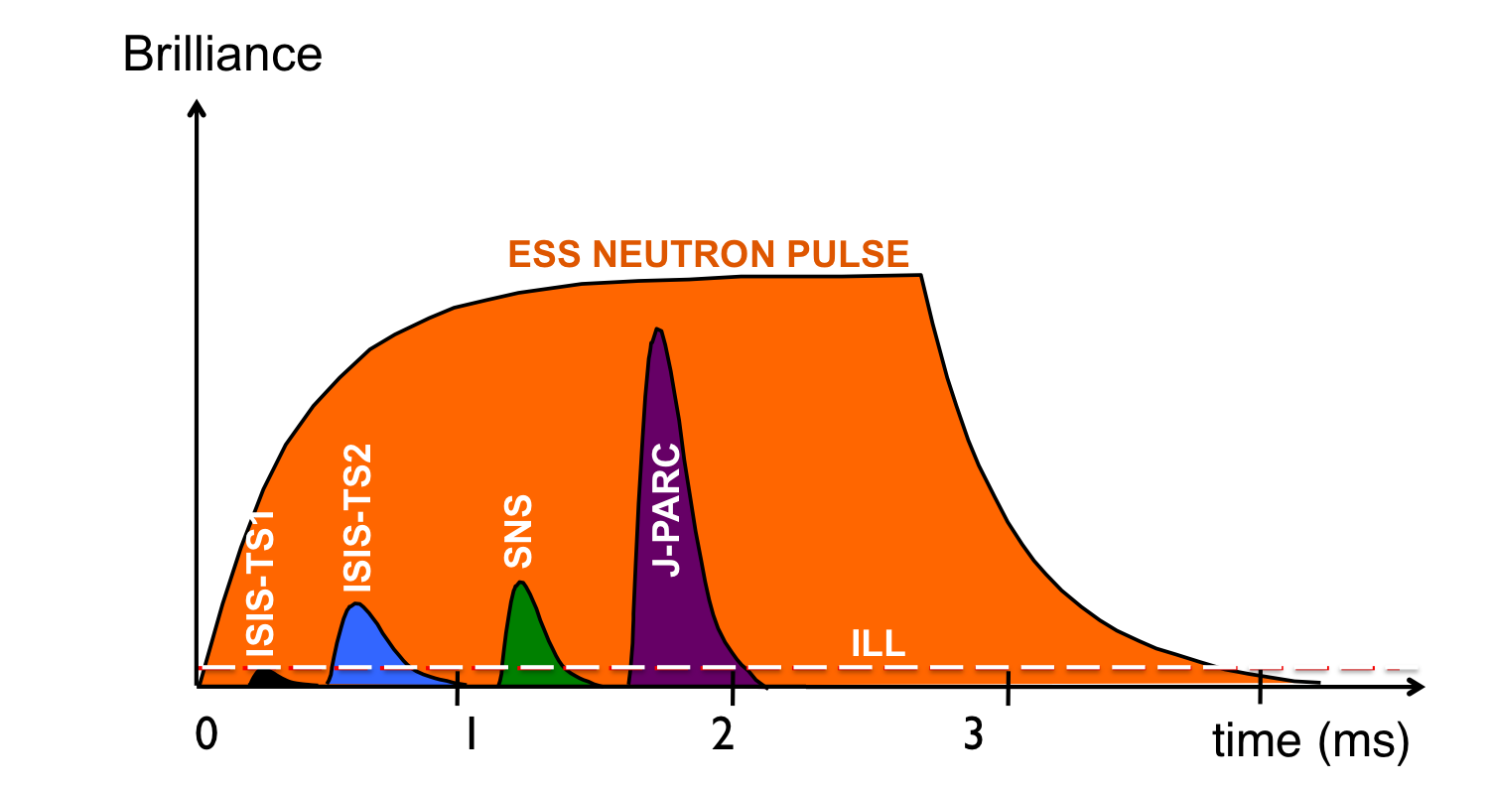

Slide 4
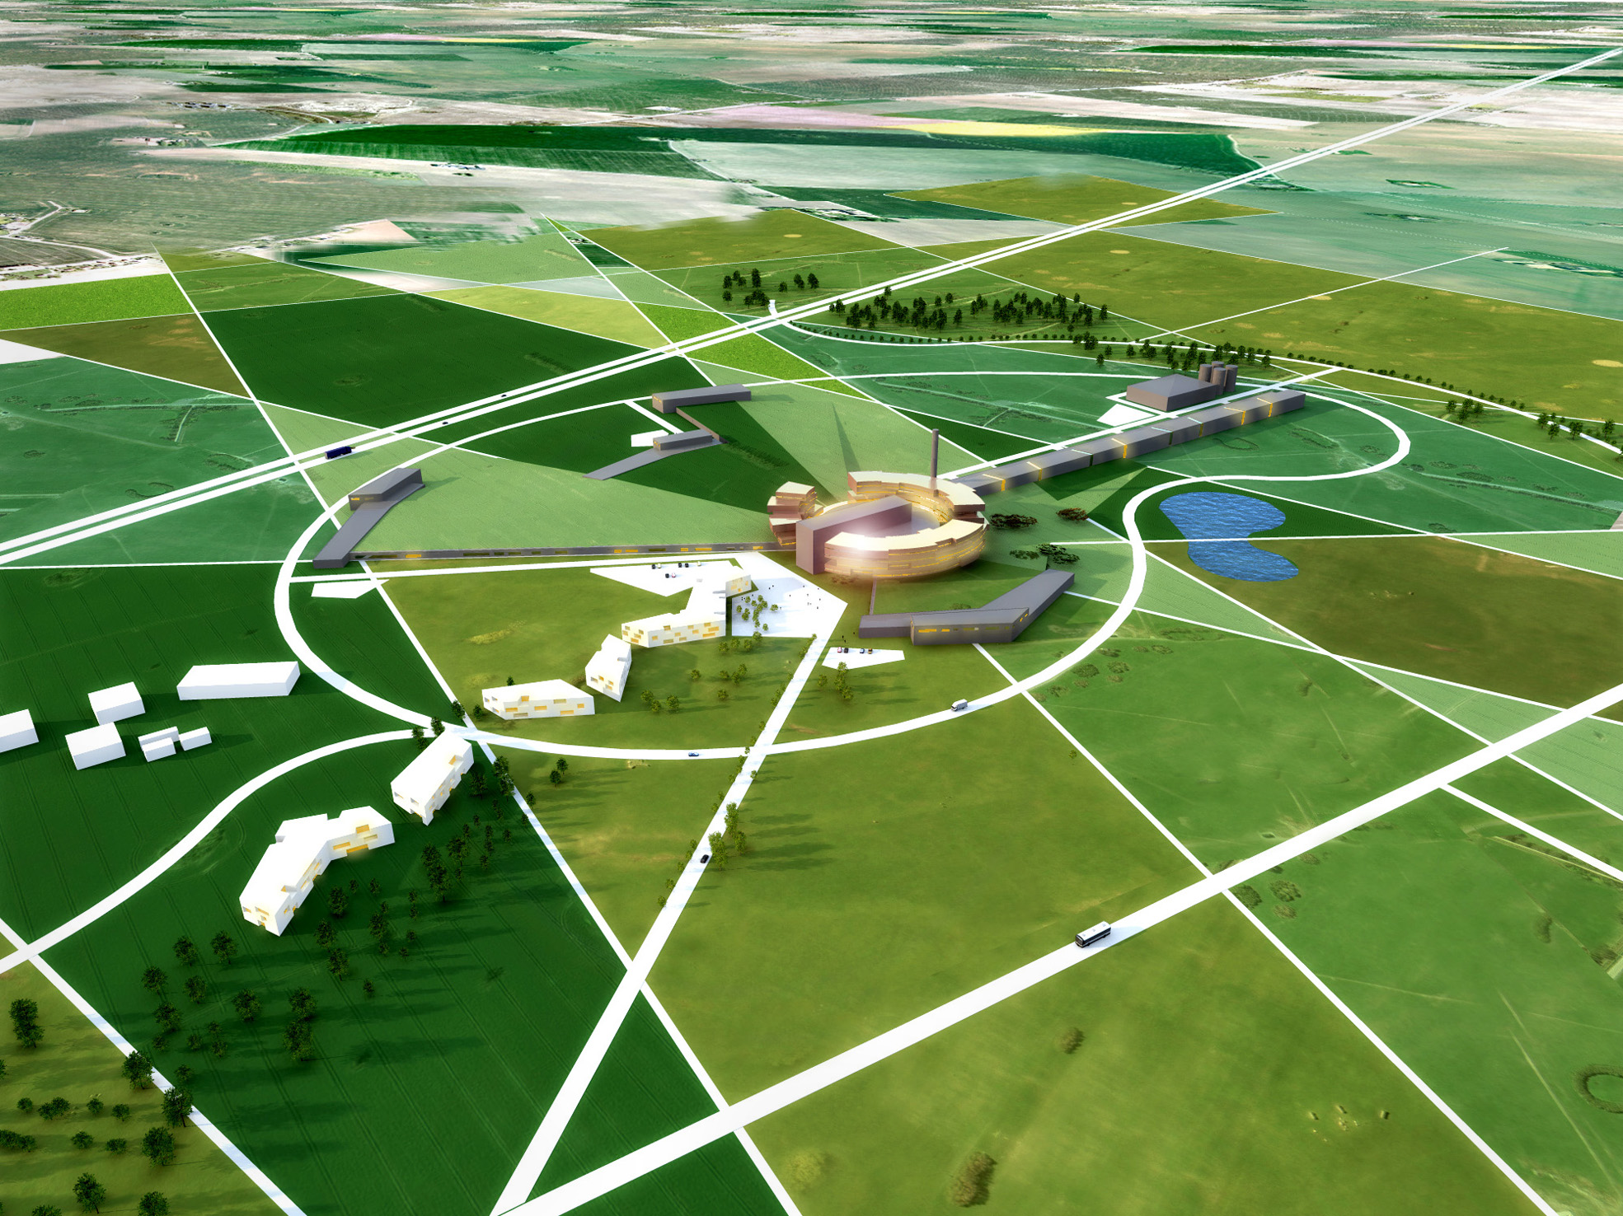

Slide 5
ESS - The INFN contribution
X
X
X
3,6 MeV
93 MeV
2000 MeV
INFN has been involved in the Design Update phase (2011-12), for several components of the LINAC, and it is involved in the next phase, aimed to the construction of prototypes
  The Proton source
  The LEBT
  The Drift Tube Linac
  The Superconducting elliptical cavity @ high energy section

Slide 6














Preconstruction phase
1st ESS Steering Committee
22nd & 23rd October 2009 Copenhagen
strong support from 13 (now 17) countries to:
    to engage in the ESS Design Update
    to prepare organisation aimed for construction

Slide 7
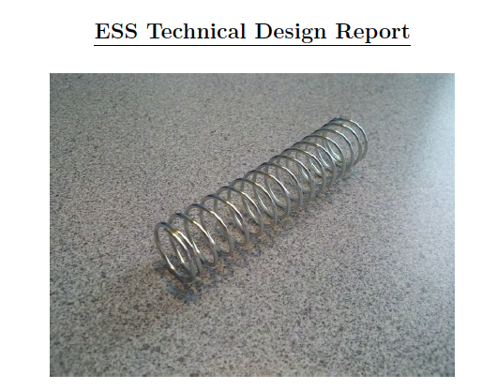
INFN contribution started in 2009 and followed during the revision of the baseline (Accelerator Design Update 2011-12) until the issue of the
1-3-2013

Slide 8
ACCSYS redesign impact
In order to minimize the cost of the accelerator (down to 497 M€) a redesign was necessary after the Technical Design Report presentation, to decrease the energy (2.5 GeV to 2.0 GeV) and to increase the current (50 to 62.5 mA).
That made the low energy section more complex, and the prototype preparation activity was affected.
The entire accelerator’s schedule has been revised successfully and after the summer 2013 the activity restarted with the due speed.
A review of the ESS design has been positively carried out in November.

Slide 9
ESS Linac
352.21 MHz
704.42 MHz
2.4 m
4.5 m
3.6 m
40 m
54 m
75 m
174 m
Target
Source
LEBT
RFQ
MEBT
DTL
Spokes
Medium β
High β
HEBT & Contingency
75 keV
3.6 MeV
90 MeV
220 MeV
570 MeV
2000 MeV
 | Energy (MeV) | No. of Modules | No. of Cavities | βg | Temp (K) | Cryo Length (m)
Source | 0.075 | 1 | 0 | – | ~300 | –
LEBT | 0.075 | – | 0 | – | ~300 | –
RFQ | 3.6 | 1 | 1 | – | ~300 | –
MEBT | 3.6 | – | 3 | – | ~300 | –
DTL | 90 | 5 | 5 | – | ~300 | –
Spoke | 220 | 13 | 2 (3C) × 13 | 0.5 βopt | ~2 | 4.14
Medium β | 570 | 9 | 4 (6C) × 9 | 0.67 | ~2 | 8.28
High β | 2000 | 21 | 4 (5C) × 21 | 0.86 | ~2 | 8.28
HEBT | 2000 | – | 0 | – | ~300 | –

Slide 10


ESS NEW Requirements
Maximum beam current at the target: 62.5 mA
Pulse during neutron production: 2.86 ms
Beam Stability: ±2.5% (I,ε) - Beam emittance 0.25 π mm mrad
New RFQ input Twiss parameters
The peak beam current to be able to be varied from 6.3 mA to 62.5 mA with a maximum step size of 6.3 mA and with a precision of 1.6 mA.
Proton current needed from the source 70 mA circa and
total drain current above 85 mA is expected
Extraction redesign needed
Huge impact of Mechanical design and beam
dynamics in the low energy part
DTL main changes : 4 → 5 tanks

Slide 11
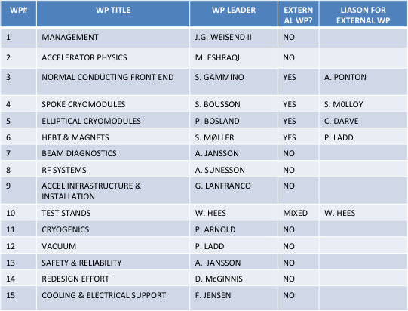
Details on AD and ACCSYS organization
Head of Accelerators
Mats Lindroos
Deputy division
Håkan Danared
Deputy project
John Weisend II
Chief engineer
David McGinnis
Safety & Availability
Andreas Jansson
Planning manager (PMO)
Mikael Klein Velderman
Division and project aligned at high level
  WP as groups would make for too big fragmentation
Weekly or bi-weekly meetings t ESS Accelerator Division
  Management board of project and division
  WP leaders
  Lead engineers
  Safety
Regular meetings for ACCSYS project
  Technical board (all WP leaders and reps of labs/uni with contract) as governance and CCB on project level (6 a year)
  Collaboration board with reps of director of of labs/uni with contracts as oversight committee
  Audits yearly of every WP
  Reviews (Conceptual, design, ready to build) as required
Beam Physics
Håkan Danared
RF systems
Anders Sunesson
Beam Instrumentation
Andreas Jansson
Specialized Technical services
John Weisend II
Lead engineers: Aurelien Ponton, Benjamin Cheymol, Stephen Molloy, Christine Darve, Peter Ladd, Tom Shea

Slide 12

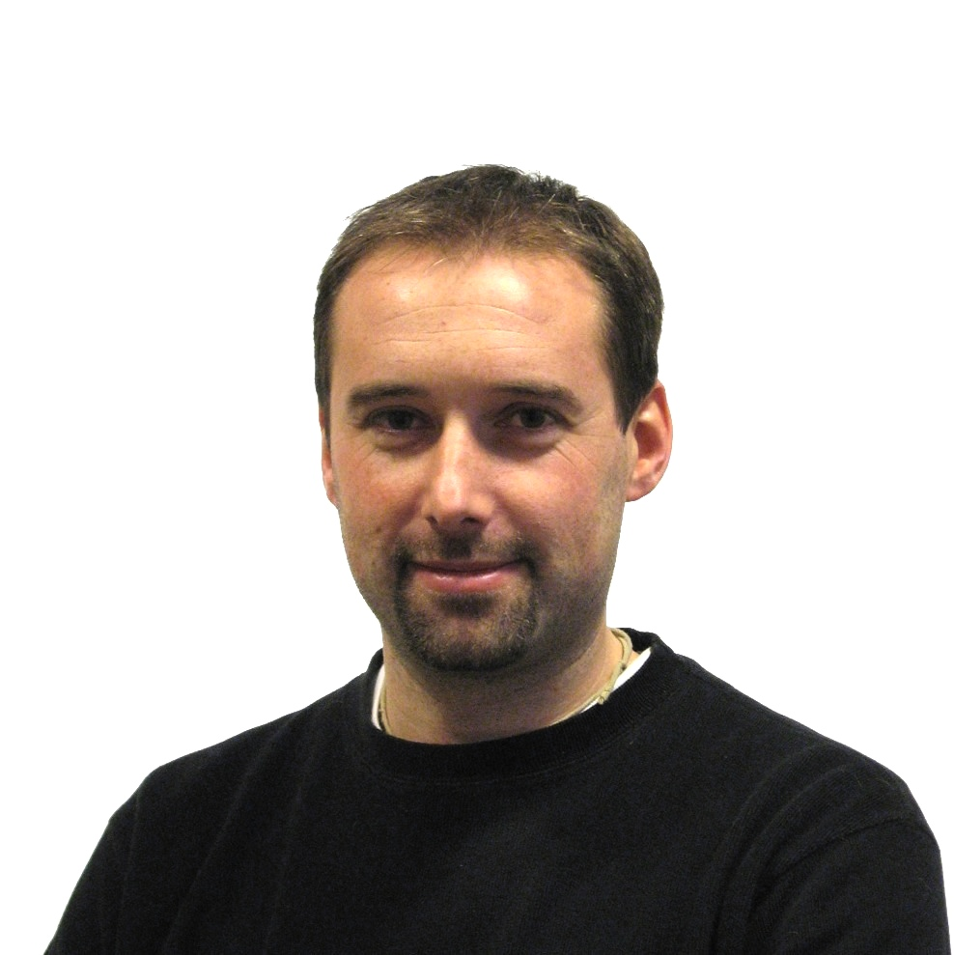


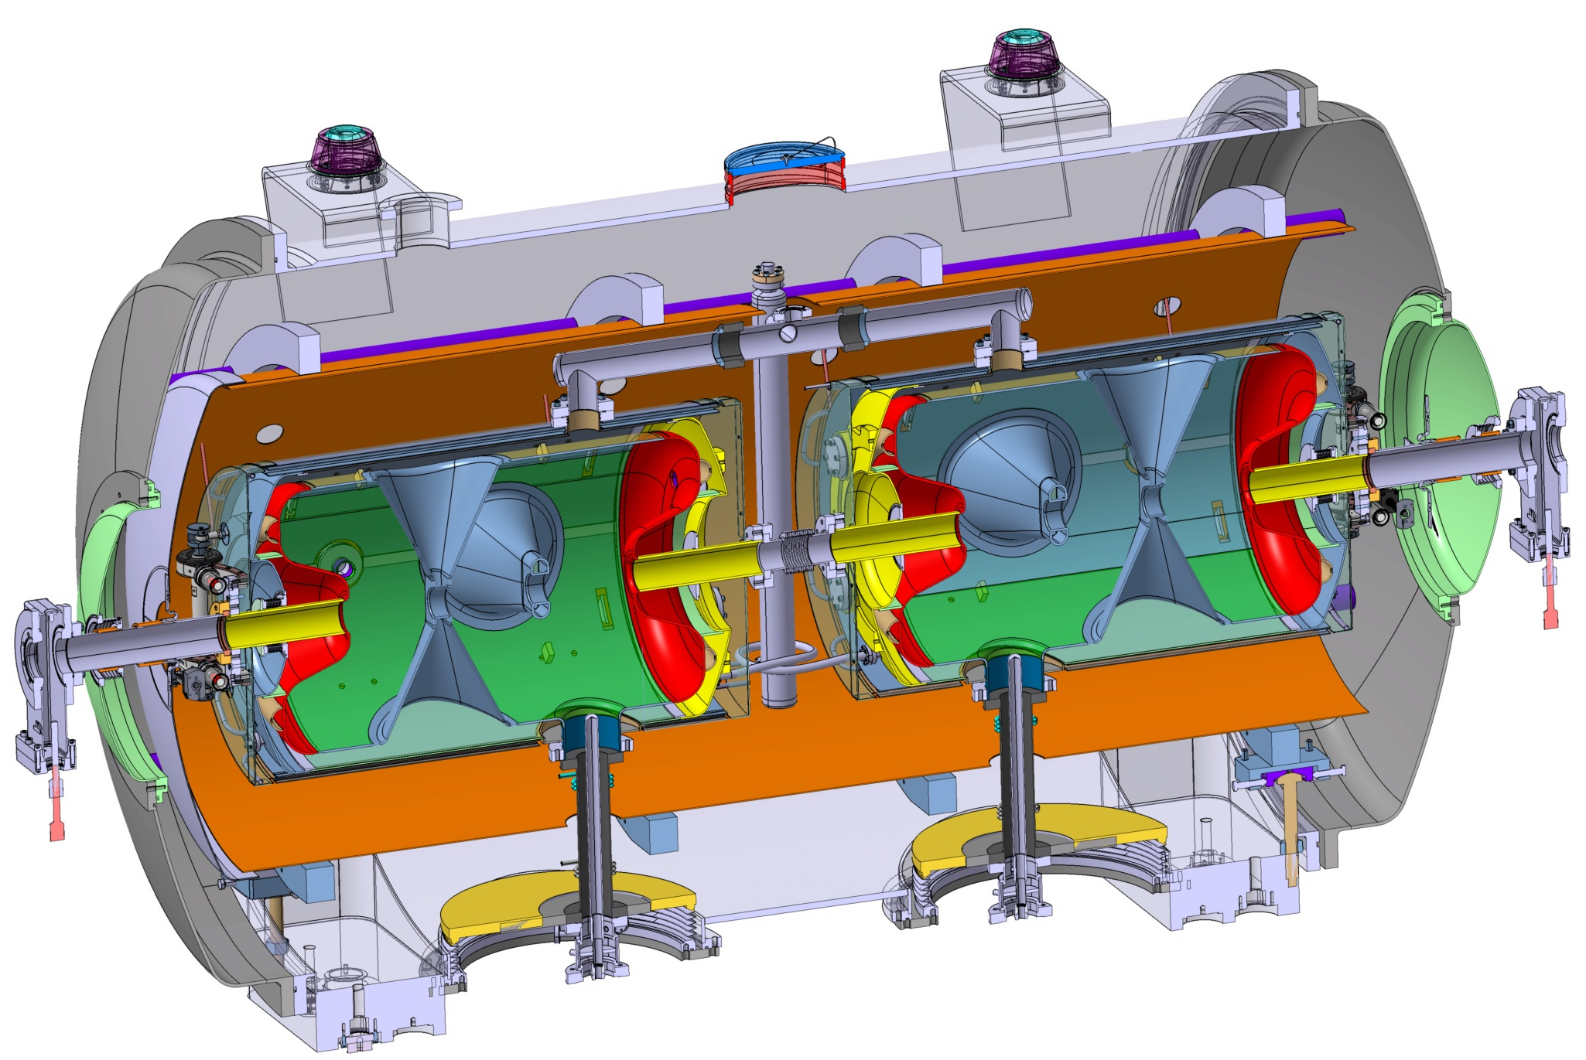
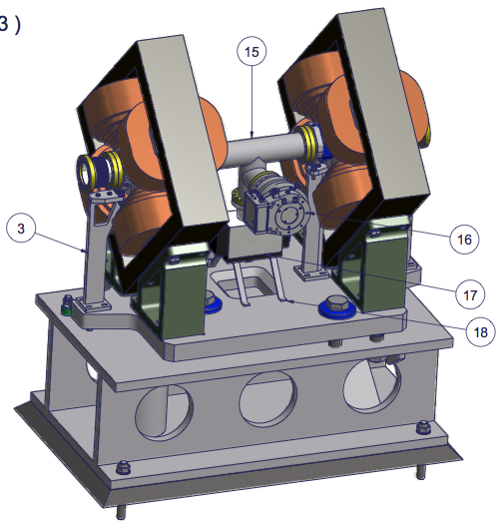
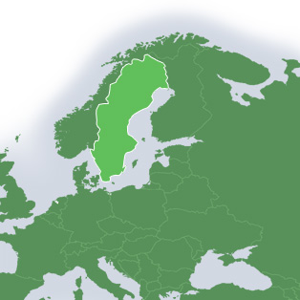
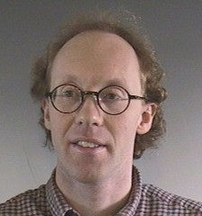


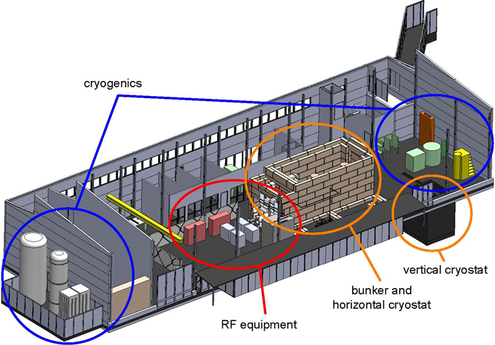
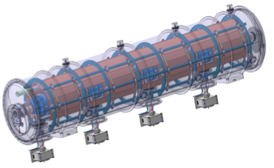

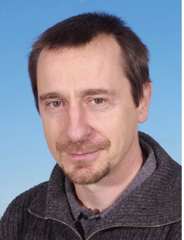
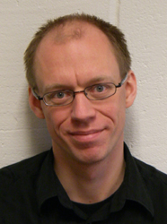
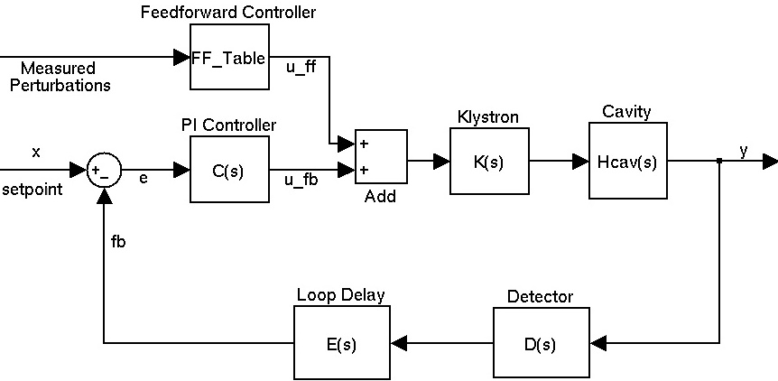

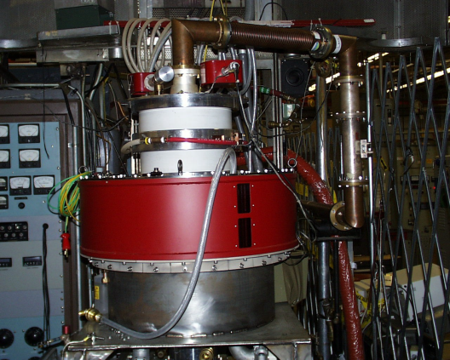


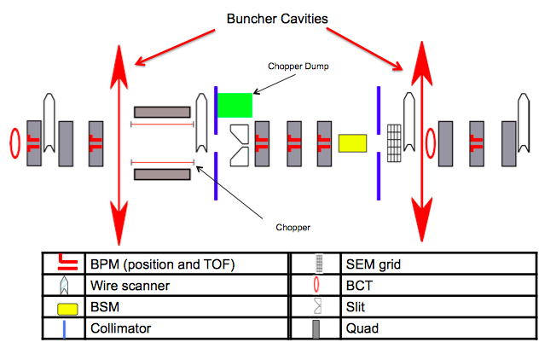
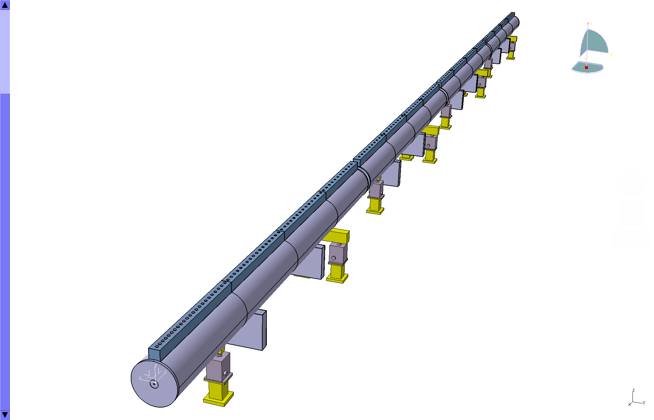

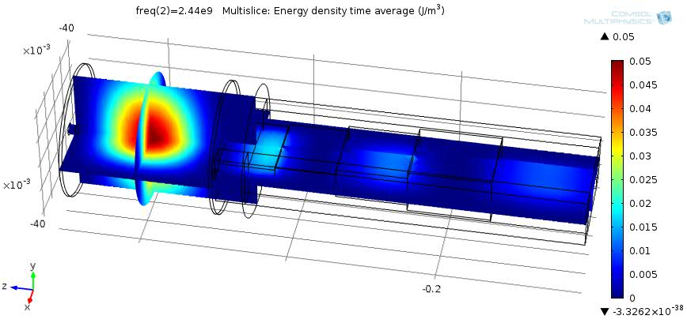
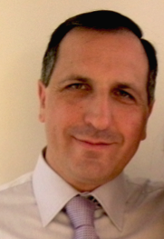

Prototyping the ESS accelerator
Søren Pape Møller
Sebastien Bousson
Roger Ruber
Pierre Bosland
Anders J
Johansson
CERN
The National Center for Nuclear Research, Swierk
Roger Barlow
Ibon Bustinduy
Santo Gammino

Slide 13
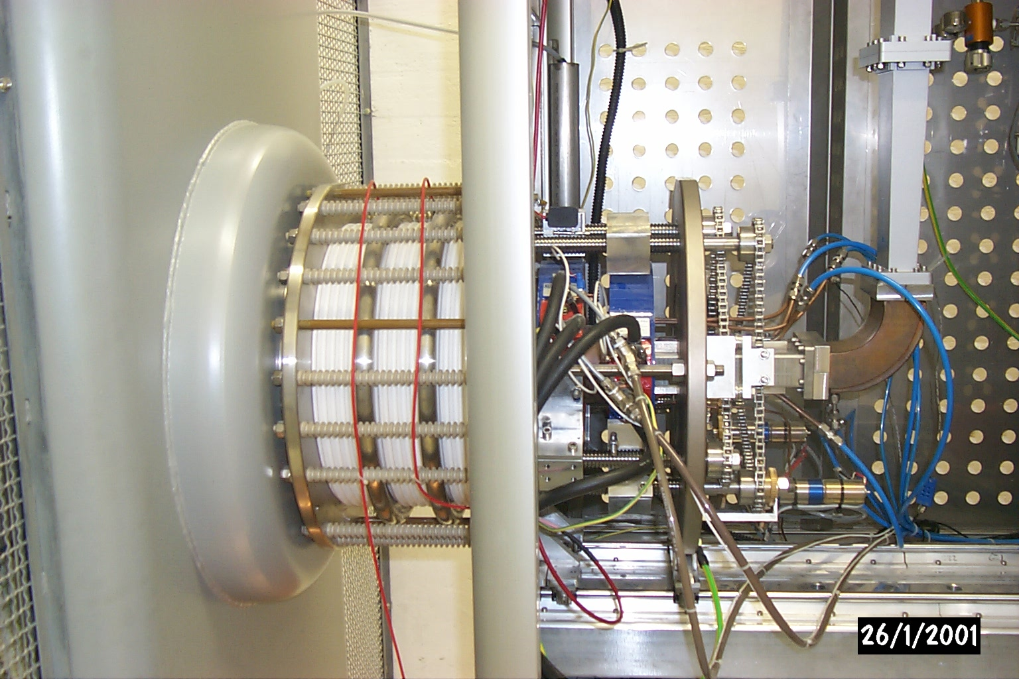
The high current proton source will be based on the know-how acquired during the design phase and the construction phase and commissioning of the sources named TRIPS and VIS at INFN-LNS and of the SILHI source at CEA-Saclay.
TRASCO INTENSE PROTON SOURCE (TRIPS)
Beam energy 80 keV
Current up to 60 mA
Proton fraction > 80%
RF power < 1 kW @ 2.45 GHz
CW mode
Reliability 99.8% over 142 h (35 mA)
Emittance 0.07 π mm mrad (32 mA), 0.15 to 0.25 at max current
Test benches available at INFN-LNS and at CEA-IRFU

Slide 14
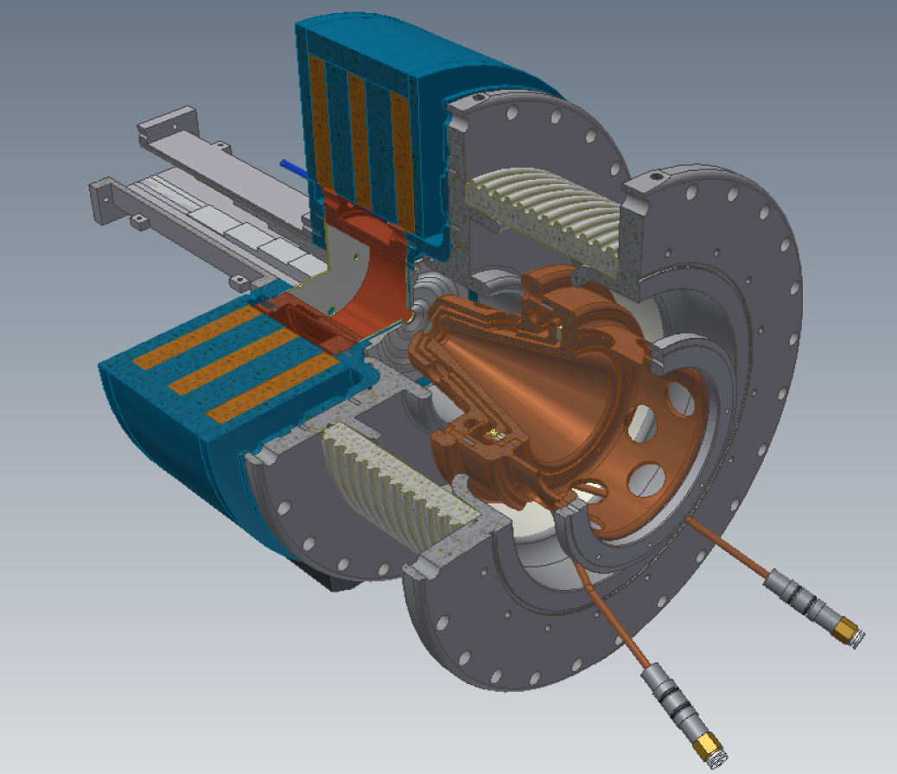
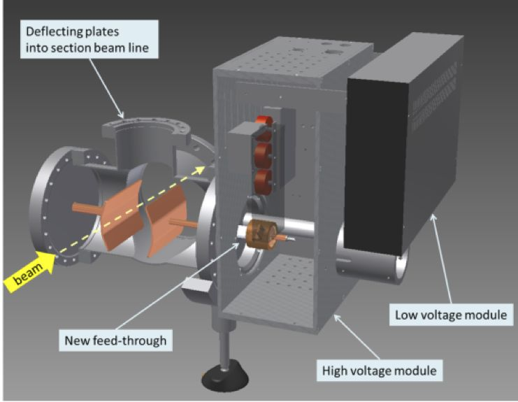
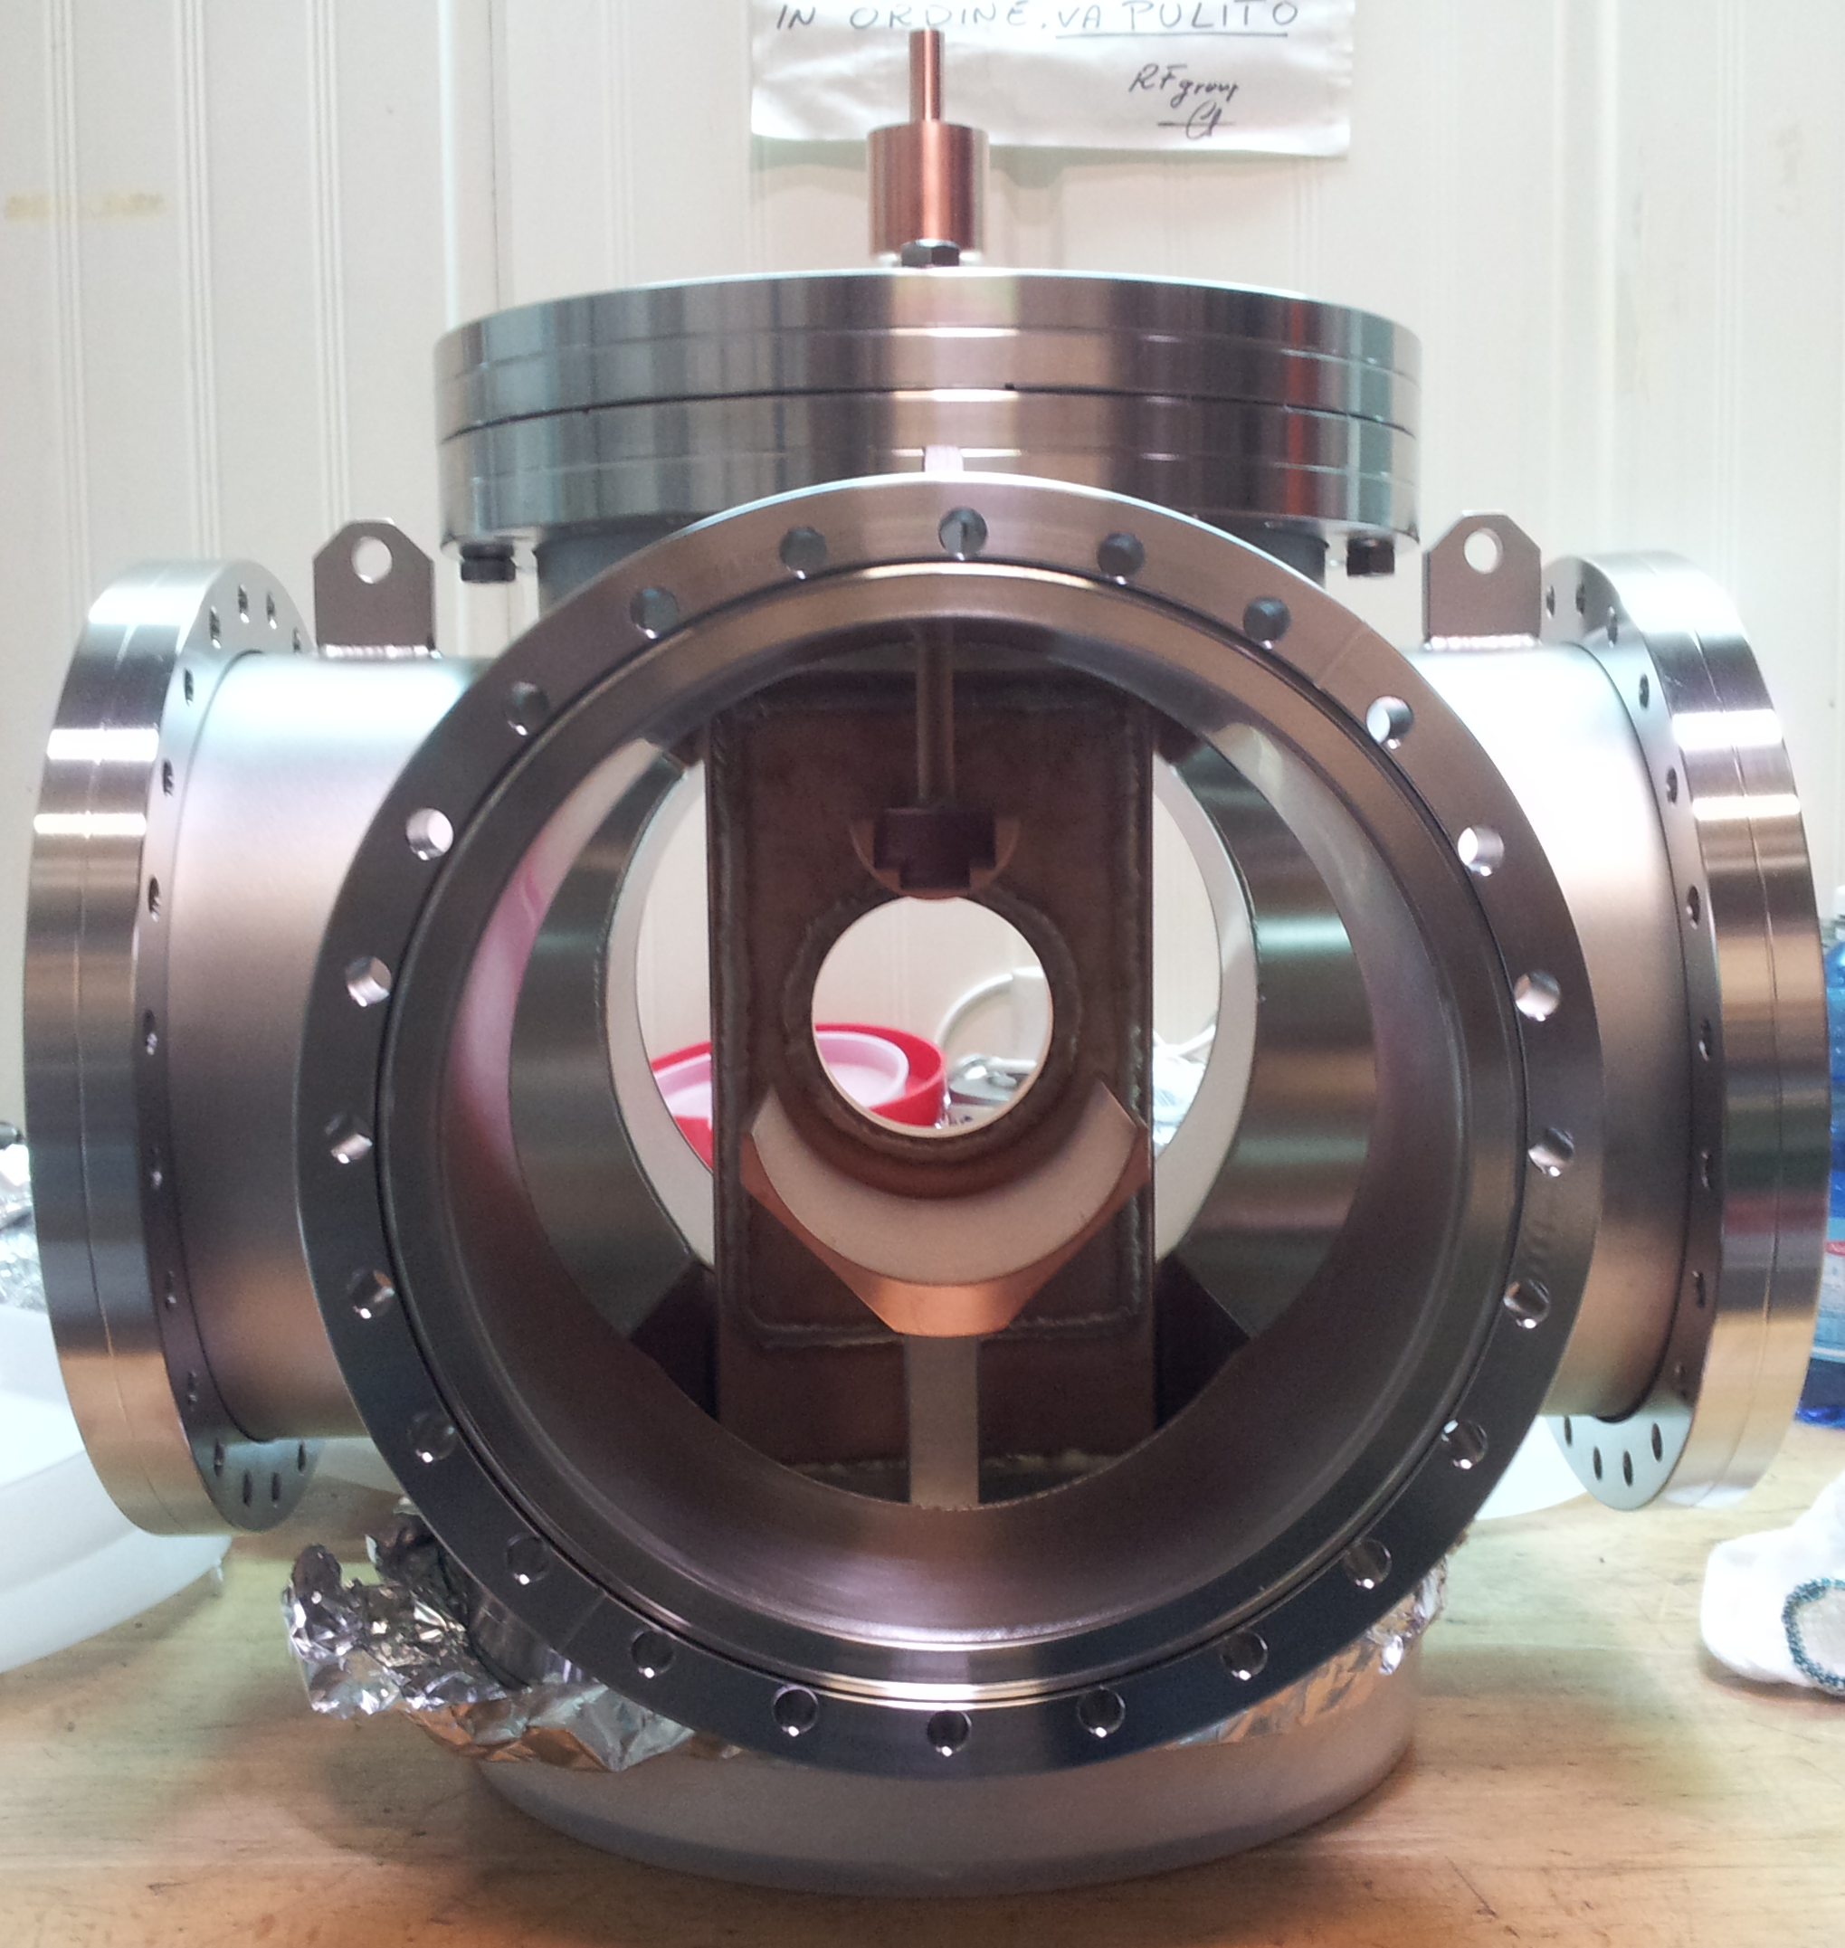
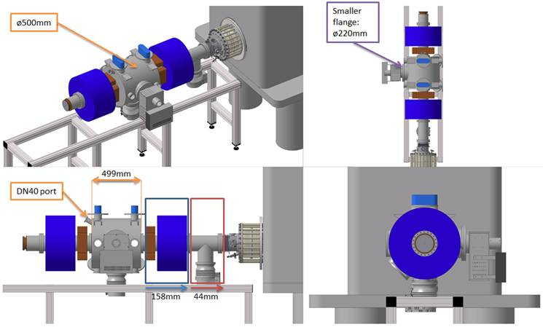
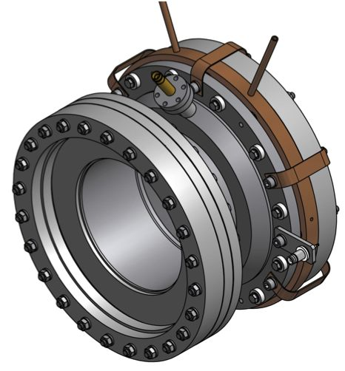
PS-ESS Source
Chopper
LEBT
Collimator

Slide 15
LEBT Beam Instrumentation conceptual design
To be determined:
Total number of diagnostic instruments
Length needed for the three instrumentation regions
Position of the stereers with respect to the solenoids
Total length of the LEBT

Slide 16

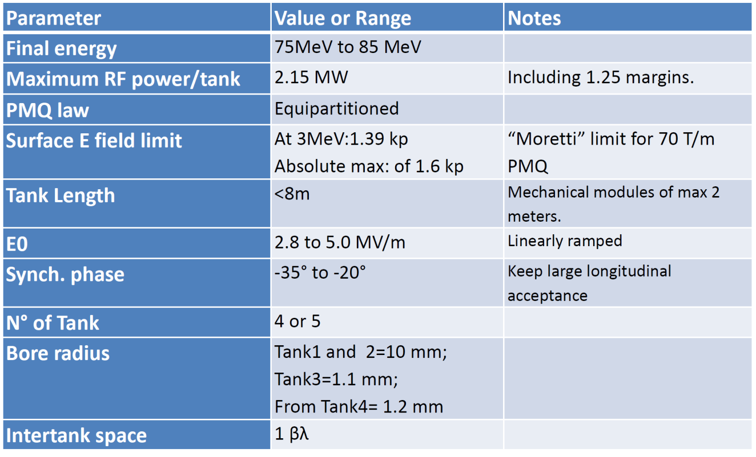
Drift tube Linac (DTL)
With 5 tanks, about 2.1 MW per each, the maximum energy may reach 93 MeV

Slide 17
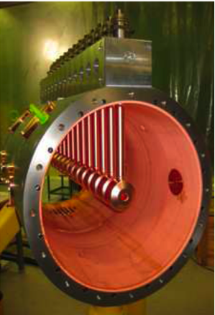
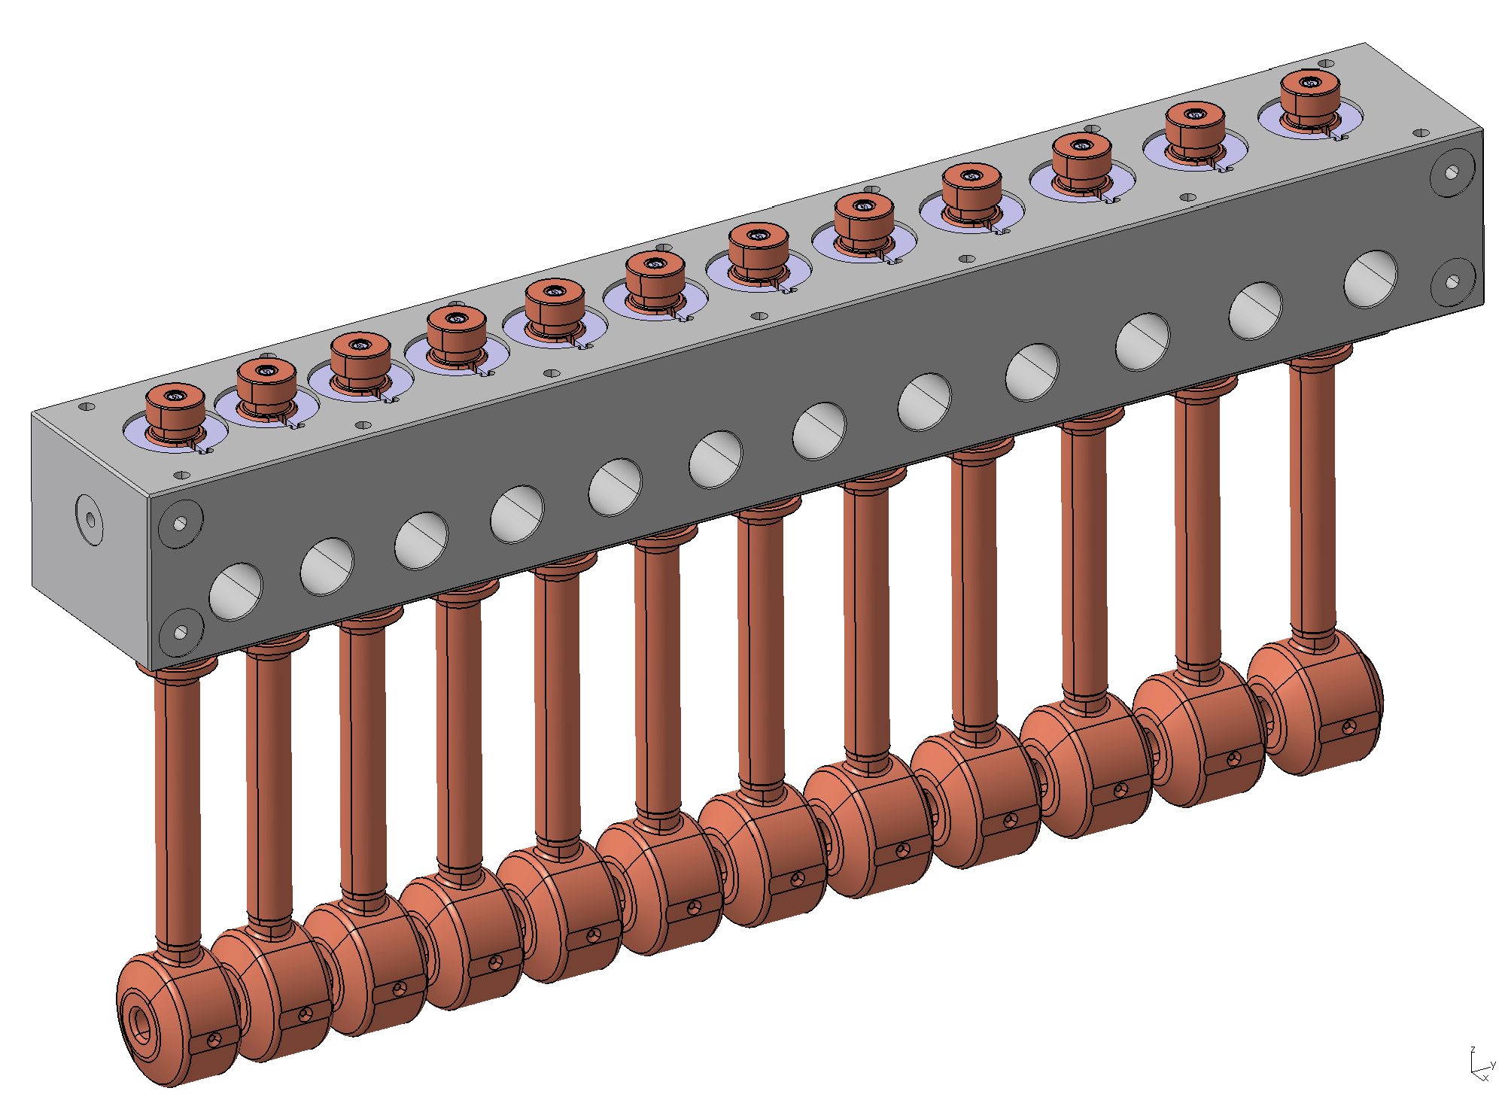
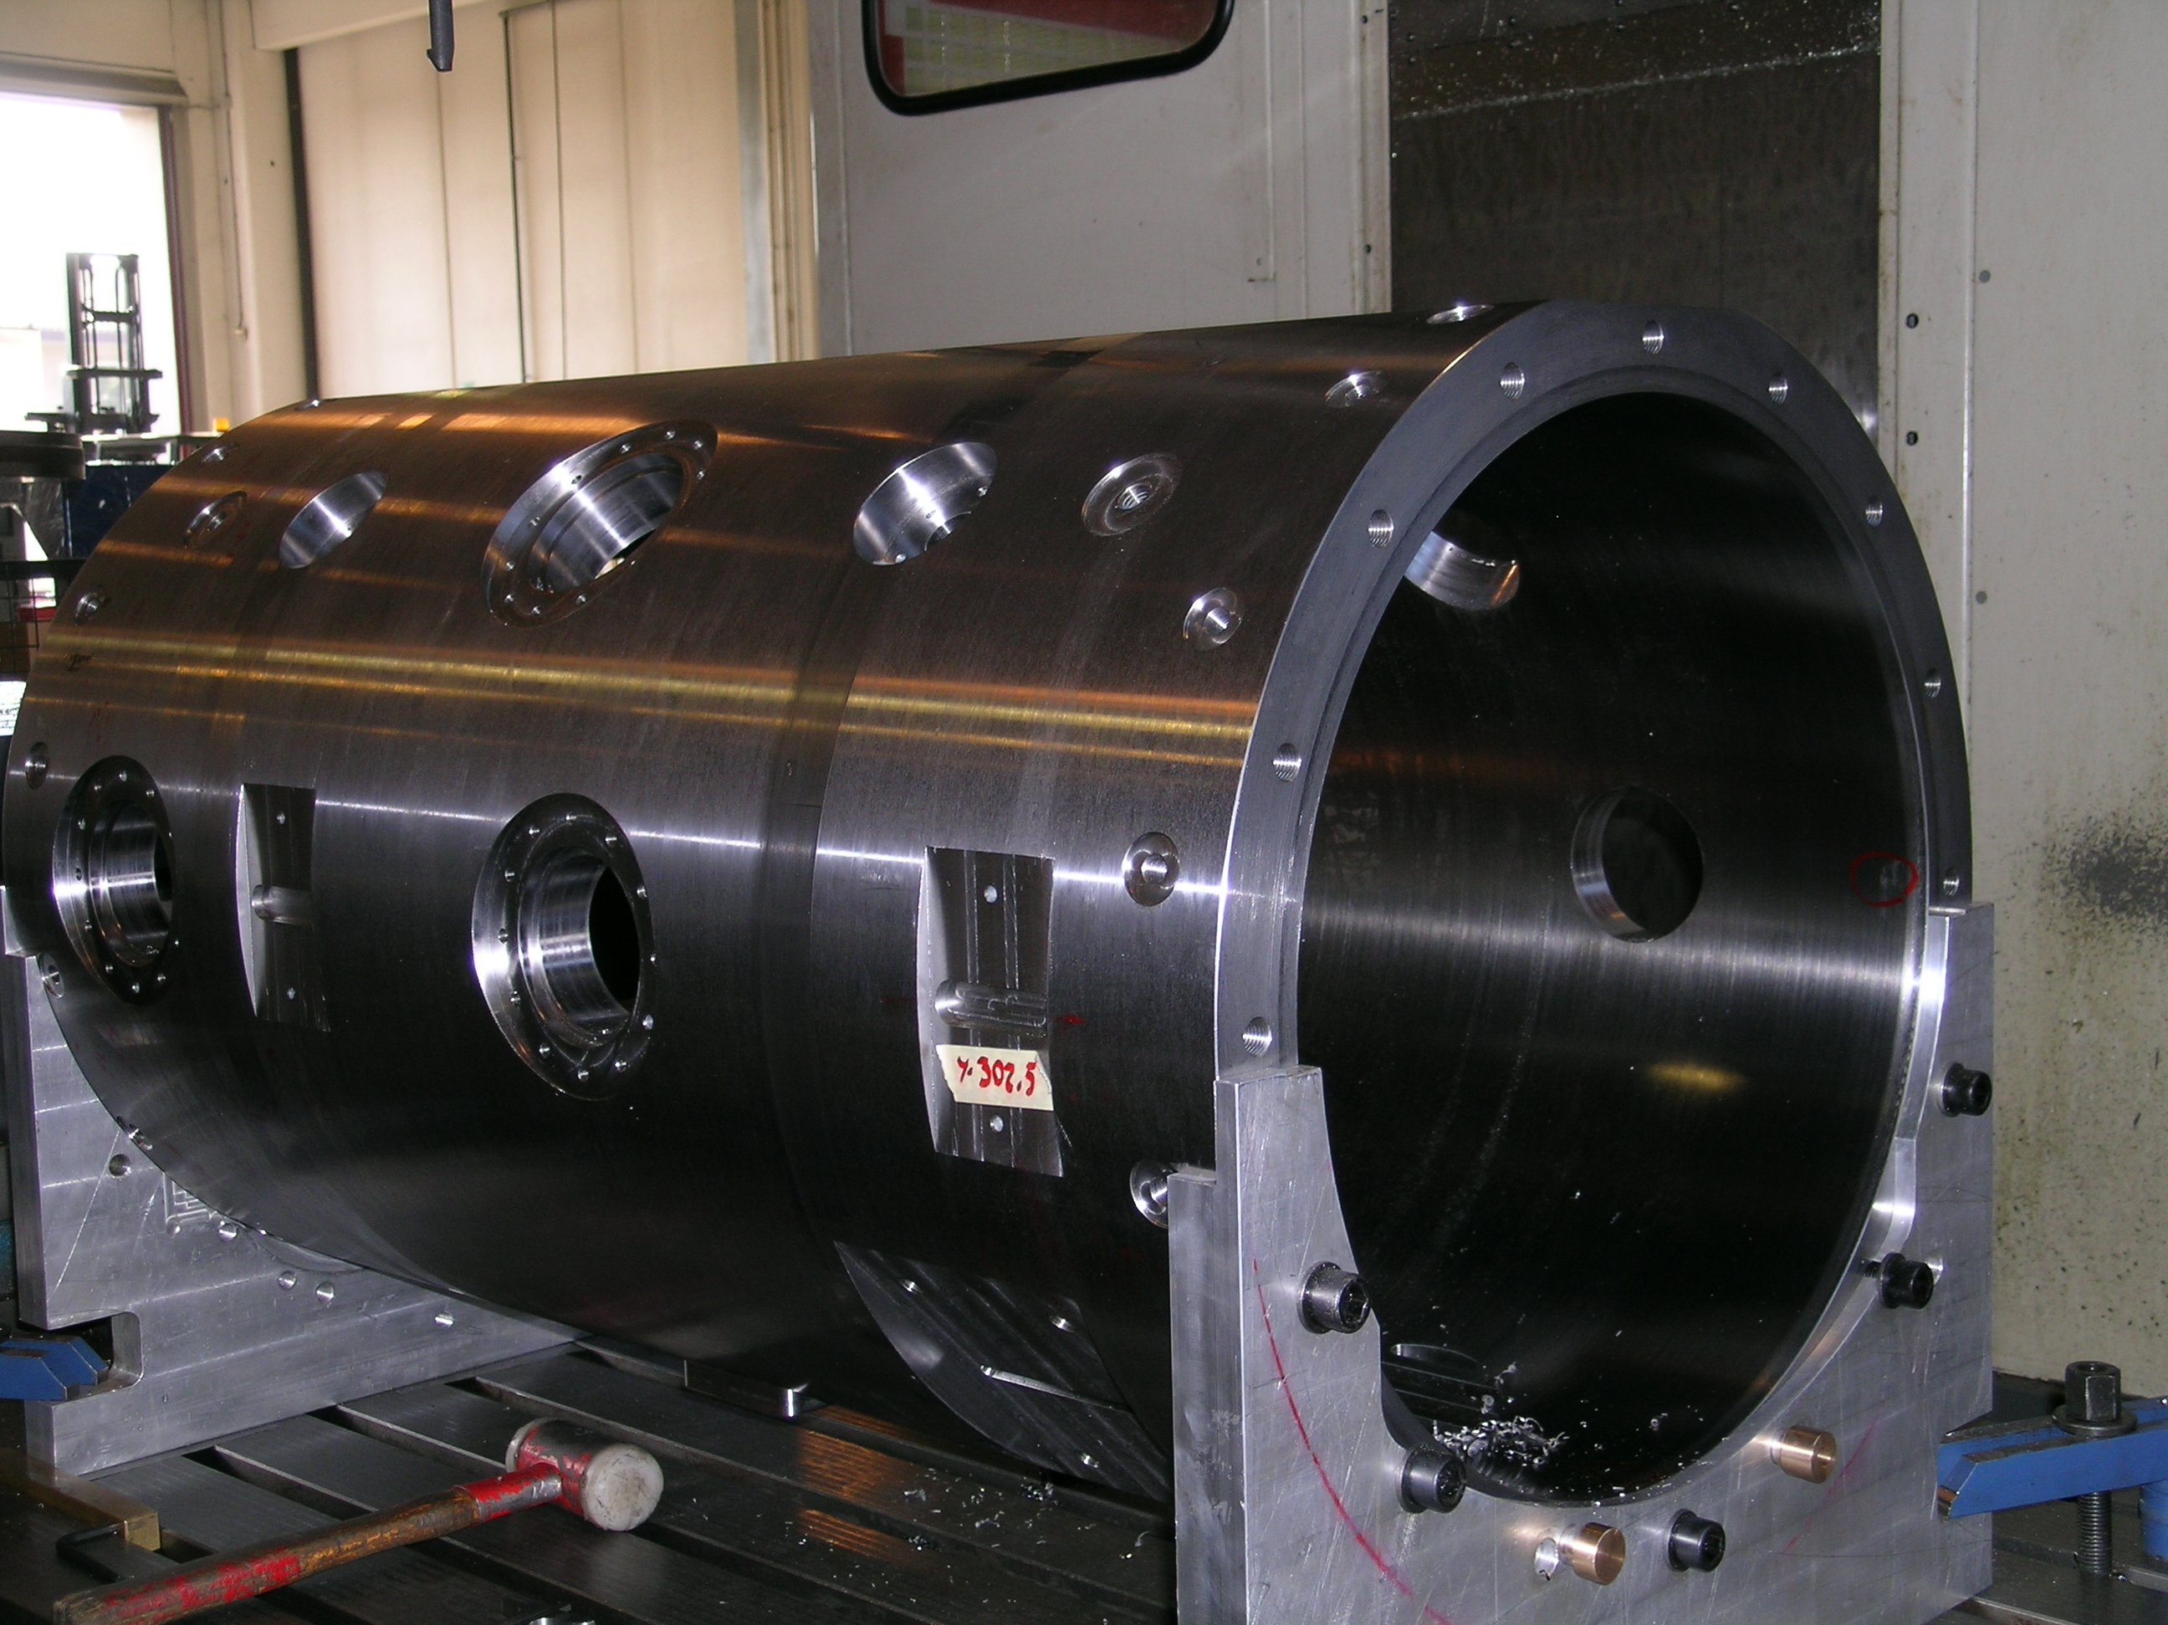
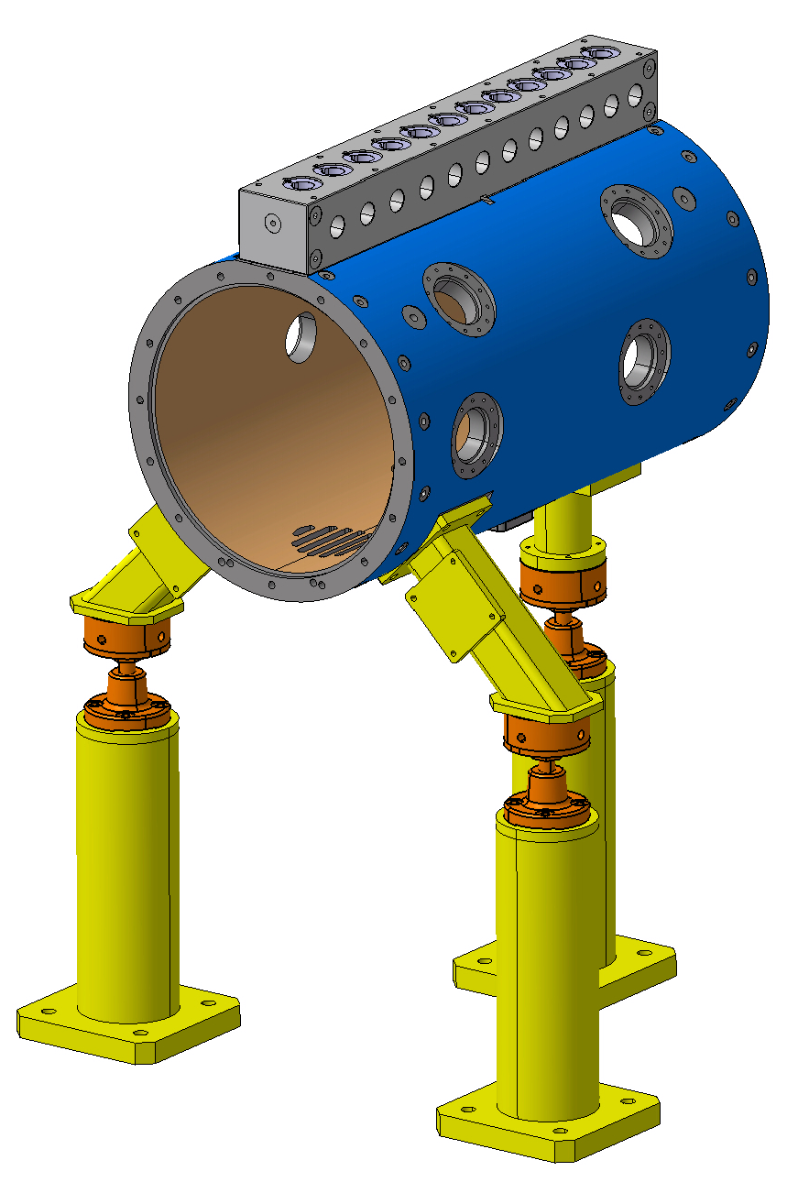
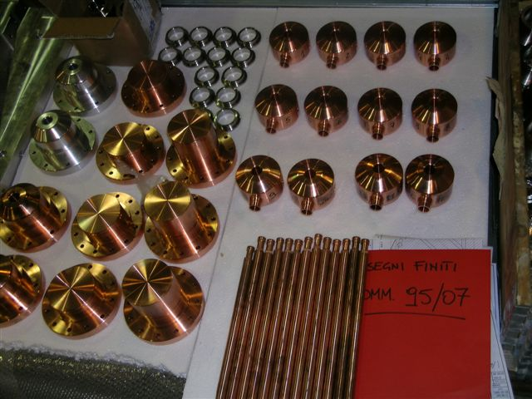
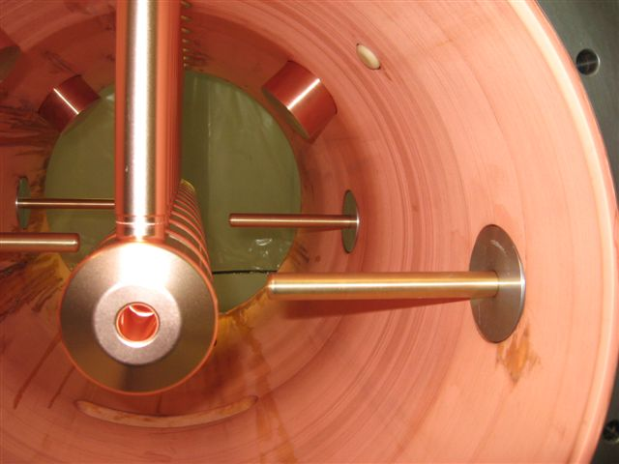
CERN-INFN DTL prototype, based on CERN design
Tank machining at Cinel (Vigonza-Italy)

Slide 18
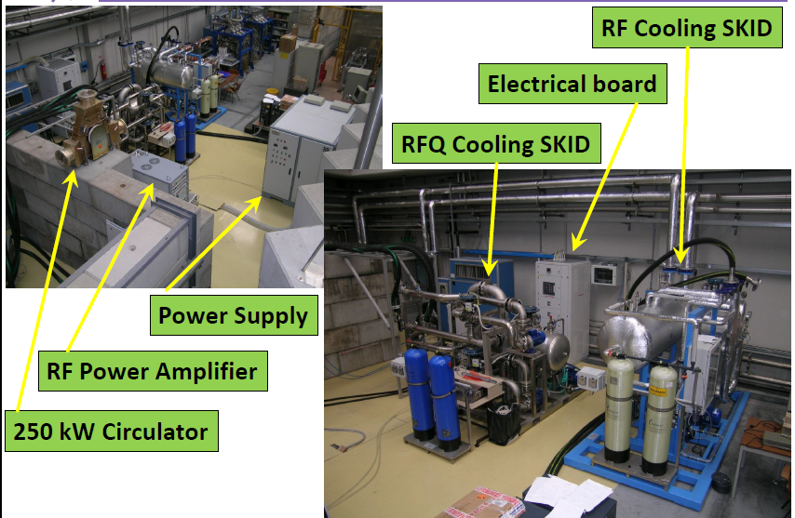
RF test stand at LNL (used now for IFMIF RFQ) will be available since 2015

Slide 19
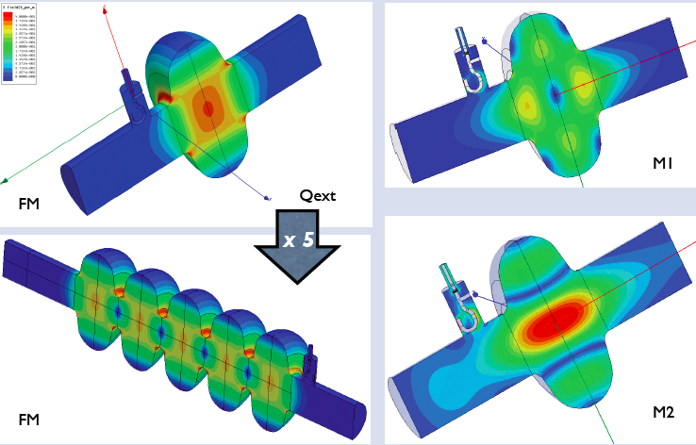
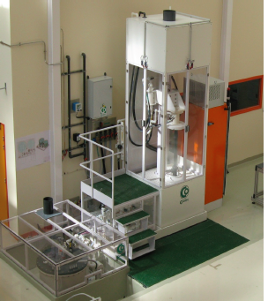
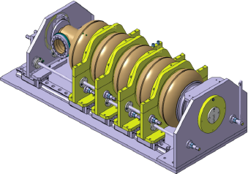
Elliptical cavities for the high energy section (superconducting)
French WP, it may be provided partially as in-kind from Italy

Slide 20
Redesign and pre-construction phase
PS-ESS proton source & LEBT
    Construction of the source started in 4th quarter 2013 (coils, power supplies, RF and high voltage components have been ordered)
    Mechanics of the PS-ESS source to be ordered in January 2014
    Chopper tests have been postponed because of the redesign (Dec. 2013 and spring 2014)

Slide 21
Redesign and pre-construction phase
Drift Tube Linac
  The DTL technical design is sound and mature enough to proceed to engineering design and prototyping.
  The redesign has driven the choice of a higher injection energy (3.6 MeV instead of 3.0) and a higher final energy (above 90 MeV)
  The DTL team has begun prototype programs to develop drift tube along with permanent quadrupole, beam position monitor (BPMs) and steering corrector, to be located inside drift tubes.

Slide 22
Redesign and pre-construction phase
Superconducting cavities
  The Milan-LASA team expertise is available for the ESS with a growing rate since 2013 and a stronger cooperation in the field is expected in the next years, when the engagement with the XFEL project will be accomplished.
  Prototype activity is going to start.

Slide 23
First impressions of Review committee
The first ESS annual review took place at LUND the 12th-14th November 2013
Present : ESS project team, 33 members of the review team organized in 7 subcommittees and 7 observers
First impressions:
The review committee congratulates the ESS team and its management for the quality of the material and presentations submitted to the reviewers
The ESS is now a real project from all points of view, well shaped and well organized. ESS is now managing to the established baseline.
A big effort was made in the last 10 months to build up an organization structure with names and clear responsibilities attached to it
The management of the project is strong, well determined, motivated and success oriented. The ESS overall schedule foresees first protons on target in December 2019. The cost cap has been fixed to 1.843 Beuro (year 2013).
ESS will start real construction work in June 2014 (ground break)

Slide 24
Very high level Schedule
2010
11
12
13
14
15
16
17
18
19
20
21
22
23
ESS ADU starts
Redesign approved
Conceptual Design
First SC cavity ordered
CM prototypes launched
Spoke CM prototype available
Ellip CM productionlaunched
Decision on
Scope
SC linac 570 MeV ready
SC RF
NC and FE IK contracts
Injector test at Saclay
NC linac ready
NC linac
Klystrons and IOTs ordered
Prototype IOT tubes delivered
Decision IOT or klystrons
RF for medium beta ready
RF for High beta ready
RF
Cryo dist. line orederd
Acc cryoplant ordered
Early access cryo and test buildings
Cryoplant ready
Cryogenics
Early access to tunnel
First protons to target
1370 MeV protons available
2 GeV protons available
Services, installation and com.

Slide 25
State of the art
INFN is engaged in the preconstruction phase of ESS (LNS for WP3 management and Proton Source&LEBT, LNL for the DTL, Milan-LASA for the SC cavities; minor contributions from other INFN sections)
The schedule for prototypes’ construction is maintained, after the redesign
The possible in-kind contribution for the construction phase has been proposed and it is under consideration at ESS-AB
The preparation of the interfaces is an urgent duty before the ground break scheduled in June 2014
The schedule for the construction is aggressive but reasonable

Slide 26
INFN contribution to the European Spallation Source is one of the most recent contributions of our Institute to Science using Neutrons.
Another recent one is the proposed IRIDE facility, which has a different mission than the ESS, but that may be complementary for some applications; e.g. it may be helpful for industrial purposes, in applications already known and in edge-of-technology applications.
Though the mission of IRIDE is based on a different field, the specific applications to Neutron-based R&D may play a role.

Slide 27
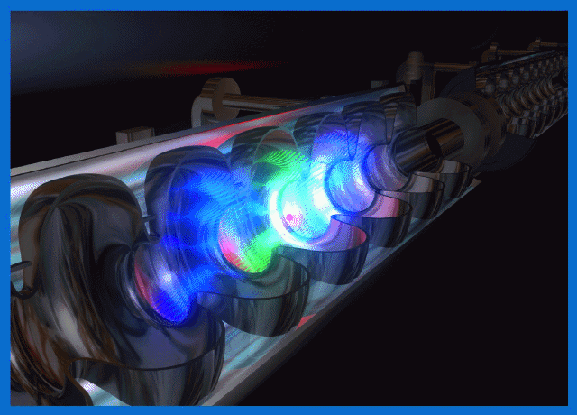
IRIDE aims and potentials
Science with Free Electron Lasers (FEL) from infrared to X-rays,
Nuclear photonics with Compton back-scattering g-rays sources,
Science with THz radiation sources,
Advanced Neutron sources by photo-production,
Fundamental physics investigations with low energy linear colliders
Physics with high power/intensity lasers,
R&D on advanced accelerator concepts including plasma accelerators and polarized positron sources
ILC technology implementation
Detector development for X-ray FEL
and Linear Colliders
R&D in accelerator technology and
industrial spin – off
Ref. IRIDE White Book: http://arxiv.org/abs/1307.7967

Slide 28






I R I D E is a large infrastructure for fundamental and applied physics research. Conceived as an innovative and evolutionary tool for multi-disciplinary investigations in a wide field of scientific, technological and industrial applications, it will be a high intensity “particle beams factory”.
n,π^{ο}
10¹⁴
e⁺
10⁹
PWA
γ
10³²
GeV
GeV
GeV
10³⁰
2K-CRYO
2K-CRYO
Based on a combination of a high duty cycle radio-frequency superconducting electron linac (SC RF LINAC) and of high energy lasers it will be able to produce a high flux of electrons, photons (from infrared to γ-rays), neutrons, protons and eventually positrons, that will be available for a wide national and international scientific community interested to take profit of the most advanced particle and radiation sources.

Slide 29
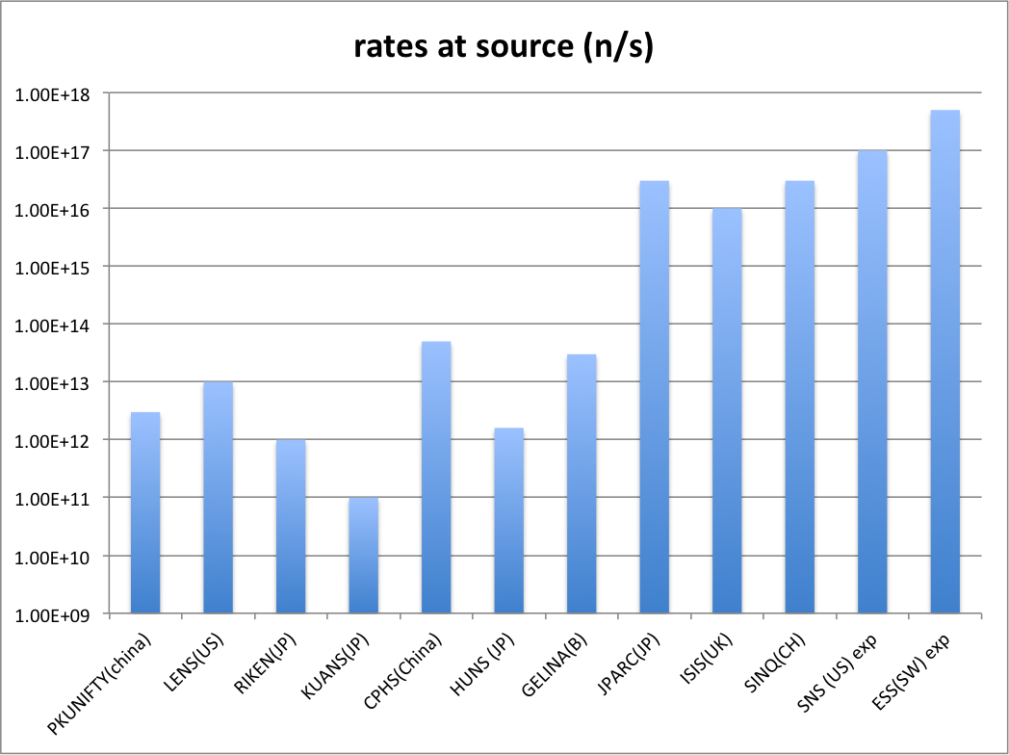
Comparison with some accelerator driven sources
Be(p/d,n)
(γ,n)
spallation
IRIDE(expected)
Continuous mode
IRIDE (expected)
Short pulse mode
Short pulse
Long pulse
continuous

Slide 30
Final remarks
INFN has been involved in the early phase of the ESS Accelerator construction and is expected to play a role also in the following years.
The know-how about High Power Proton Accelerators developed since ‘90s (TRASCO project, EU FP6, NTA Strategic Project, CSN5, etc) is recognized by the community of accelerators’ experts. That expertise was requested by ESS-AB since the Design Update in 2009.
Additionally, the sinergy with other Research Institutions in Italy and in Europe may drive the use of INFN expertise and facilities in the sense of Neutron-based Sciences.

