Slide 1



UNIVERSITÀ DEGLI STUDI DI CATANIA
Master degree in Automation Engineering and Control of Complex Systems
Electric, Electronics and Computer Engineering Department
Luca Russo
A 5 DOF manipulator for remote inspection: design, simulation, implementation and trials
Supervisors:
Prof. Eng. Giovanni Muscato
Dr. Paolo Finocchiaro

Slide 2
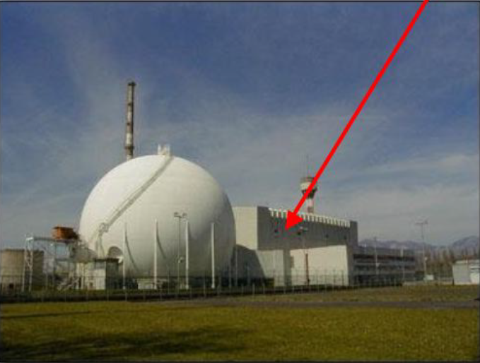
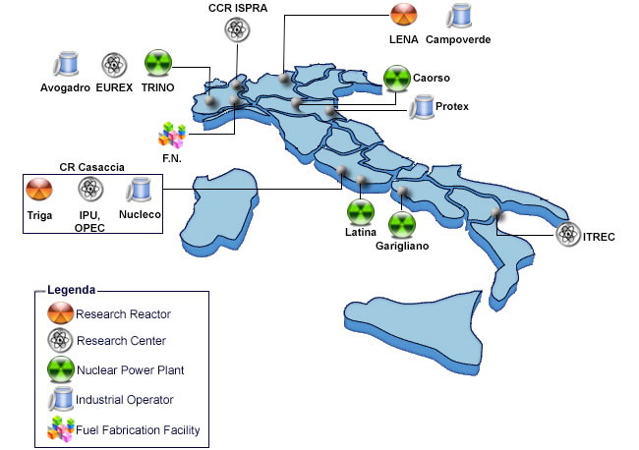
INTRODUCTION
Previous nuclear plant in Sessa Aurunca, now temporary storage site
1987
!
STOP NUCLEAR ENERGY
DECOMMISSIONING (20 storage sites in 11 regions)
80.000 m³ OF RADWASTE
Notes:
DISMANTLING,REMOVAL, DECONTAMINATION

Slide 3
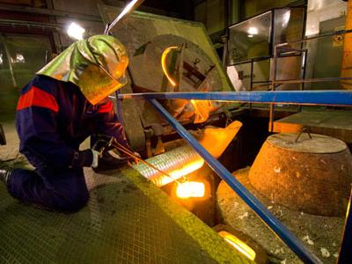


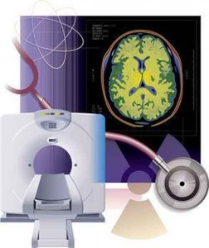
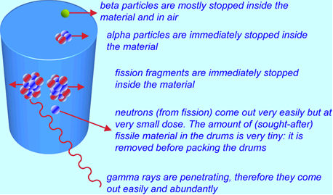
INTRODUCTION
Sources of radioactive waste:
Nuclear fission in power plants
Nuclear fuel treatment
Industrial processes
Medical applications

Slide 4
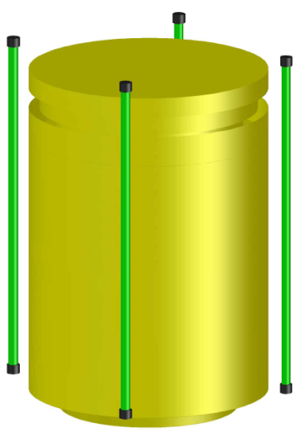
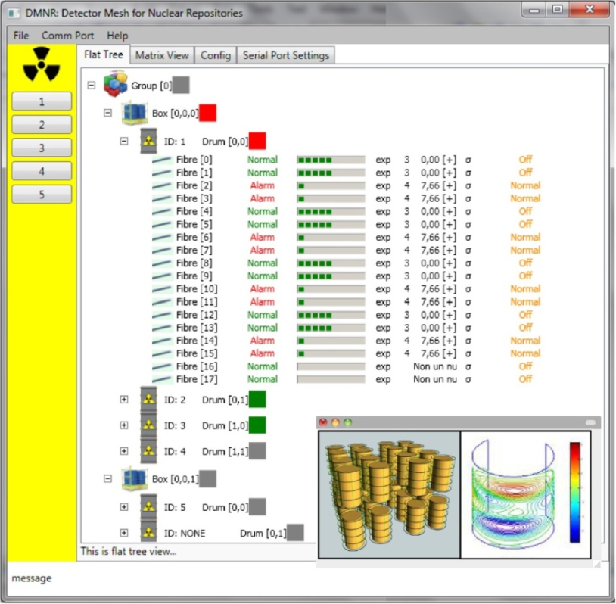
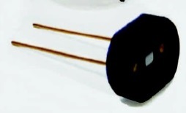
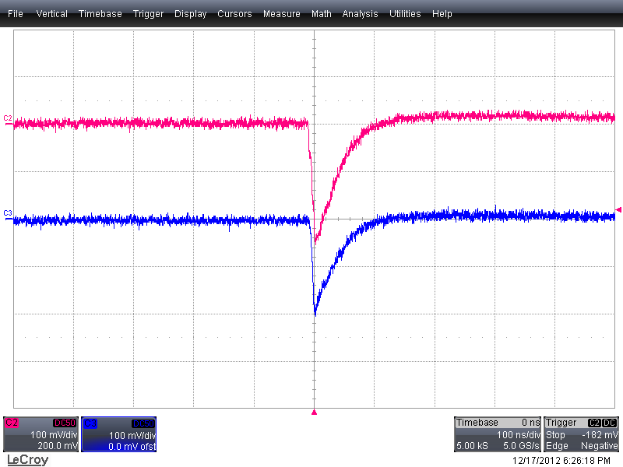
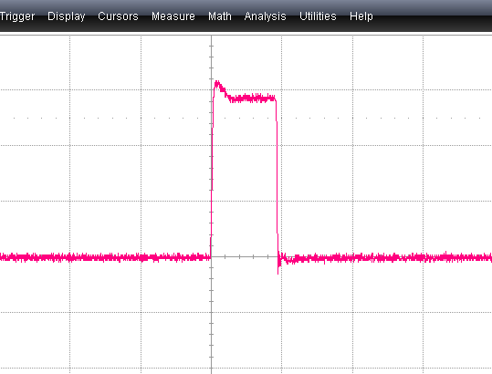

DMNR
Detector Mesh for Nuclear Repository
SiPM
SiPM
Fiber
Coincidence circuit
Counts/s
Signal coincidence
Notes:
It is a project, currently under development at INFN-LNS in Catania. The goal is the construction a proof-of-principle prototype demonstrator for the monitoring of short-medium term radioactive waste.

Slide 5
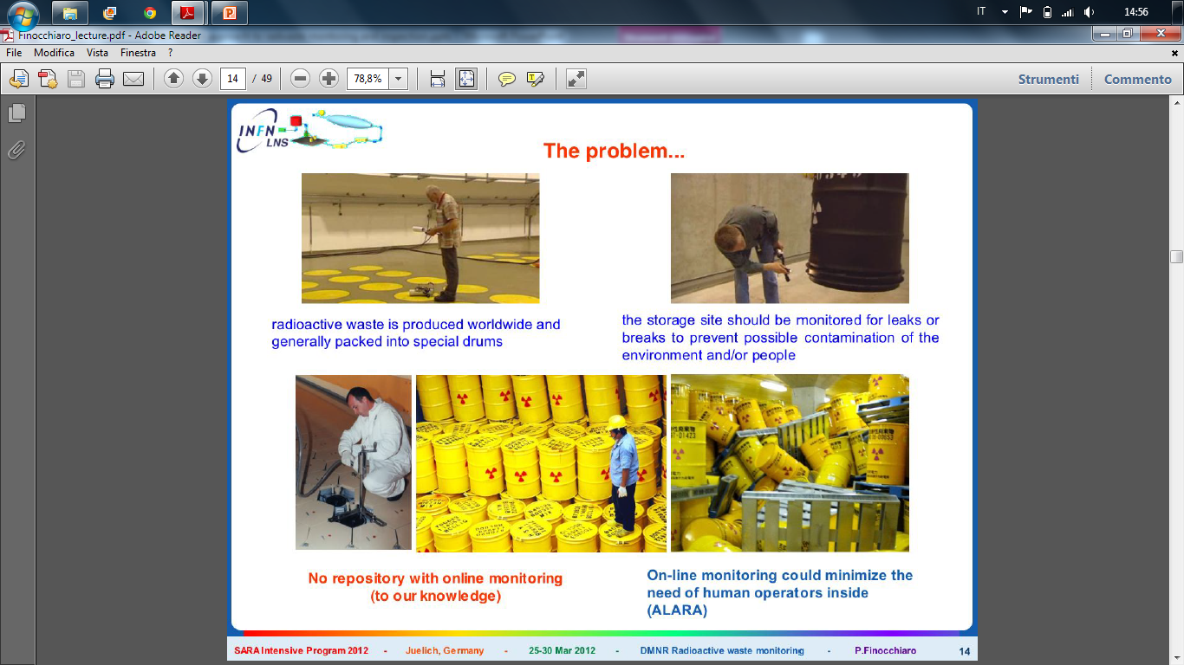
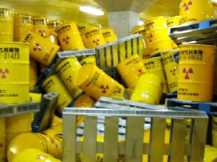
WHY ROBOTIC INSPECTION?
Minimization of direct human intervention
Higher degree of automation and repeatability

Slide 6
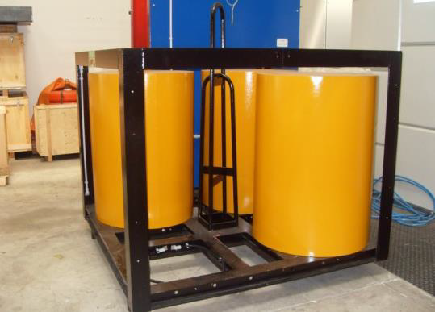
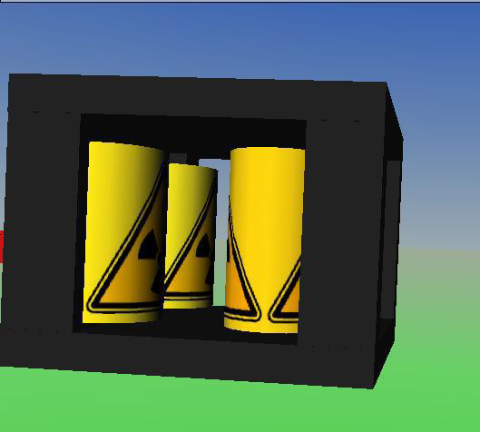
SIMULATION OF THE ARM
PALLET OF DRUMS
VRML
MATLAB
SIMULINK

Slide 7
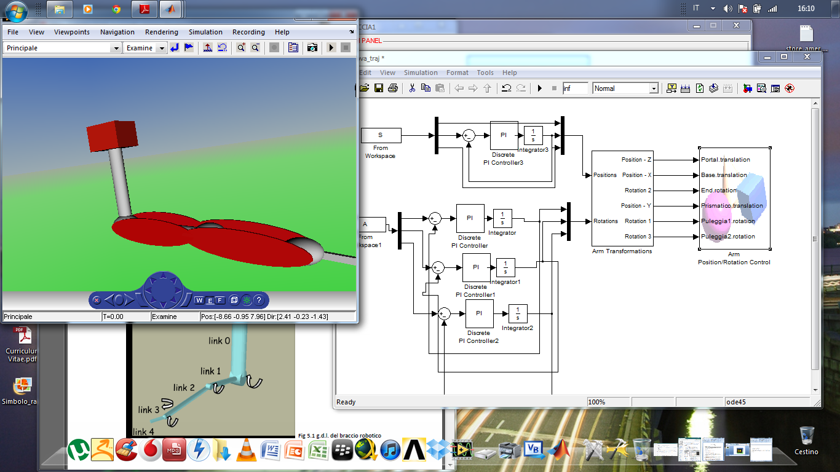
SIMULATION OF THE ARM
ROBOTIC ARM
1 PRISMATIC JOINT
2 REVOLUTE JOINTS
Link1
END EFFECTOR
Link2
Link3
End Effector

Slide 8
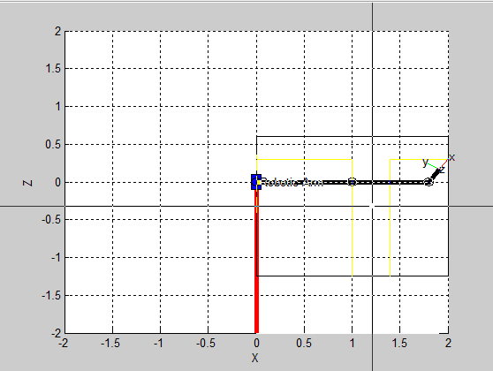
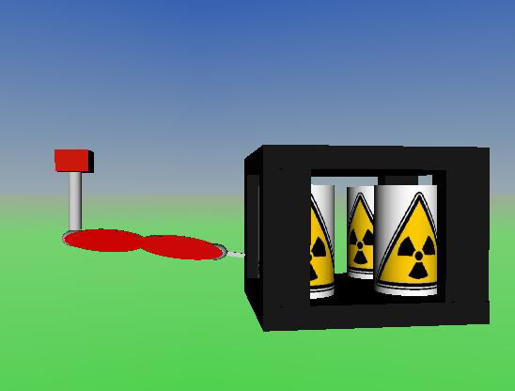
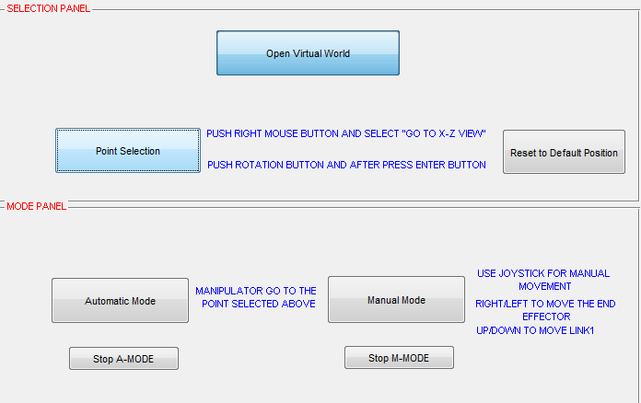
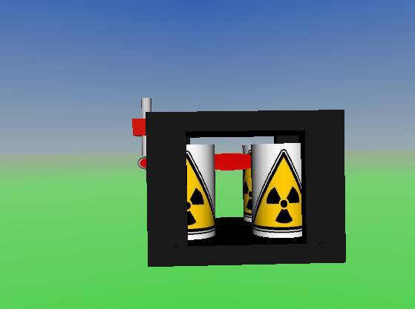
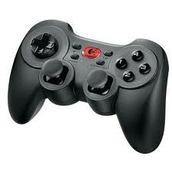
SIMULATION OF THE ARM
USER INTERFACE

Slide 9
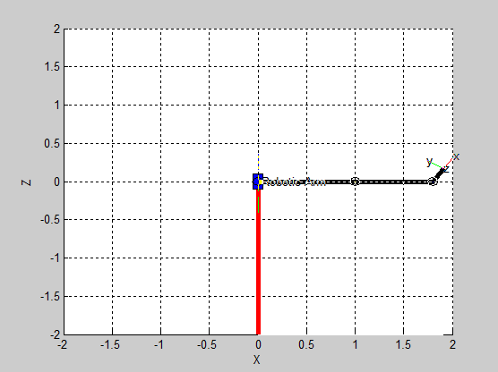
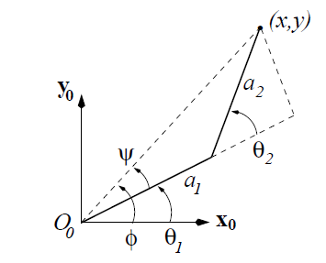



SIMULATION OF THE ARM
AUTOMATIC MODE
TWO-LINK PLANAR MANIPULATOR
THETA1
THETA2

Slide 10
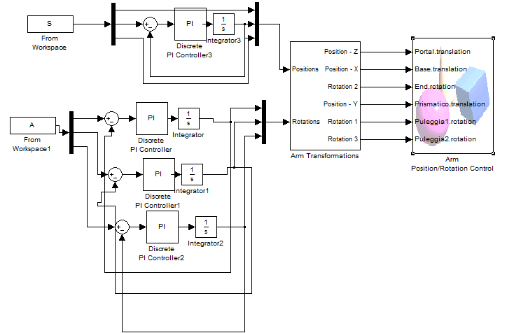
SIMULATION OF THE ARM
AUTOMATIC MODE
PI CONTROLLER
INTEGRATOR

Slide 11
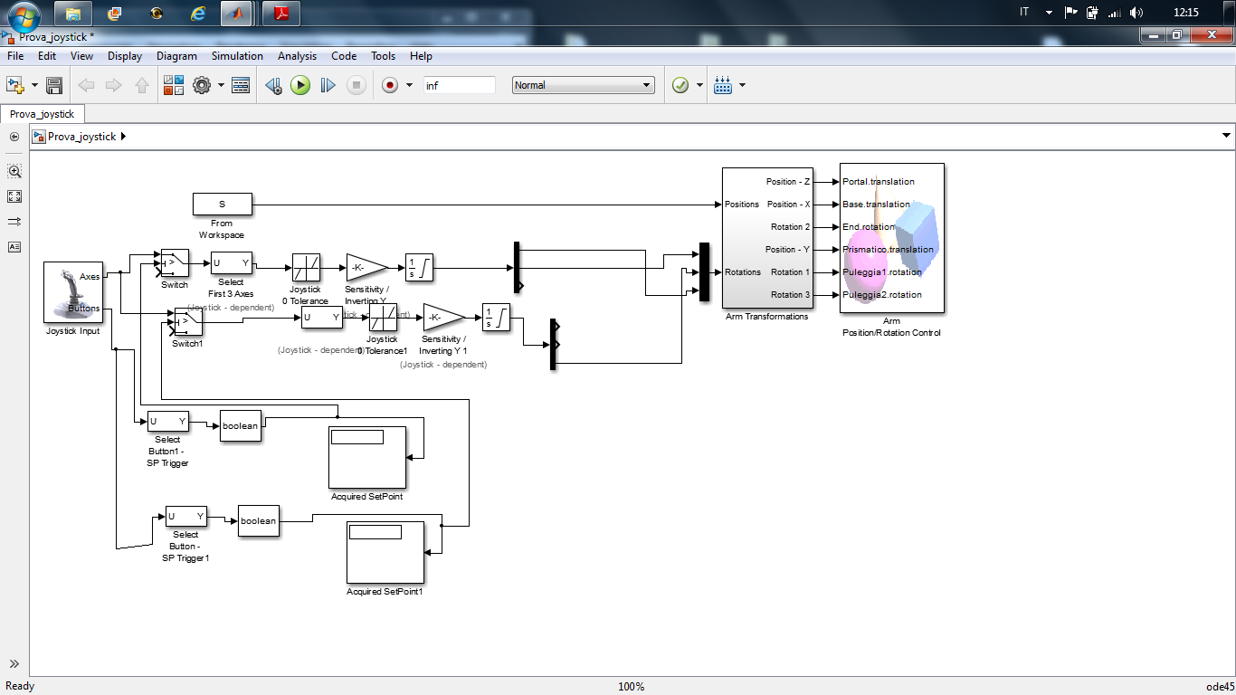
SIMULATION OF THE ARM
MANUAL MODE
JOYPAD CONTROL
ARM CONTROL

Slide 12
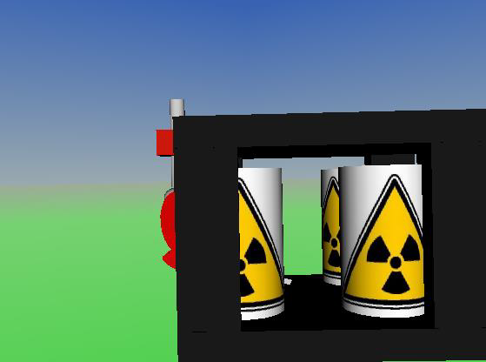
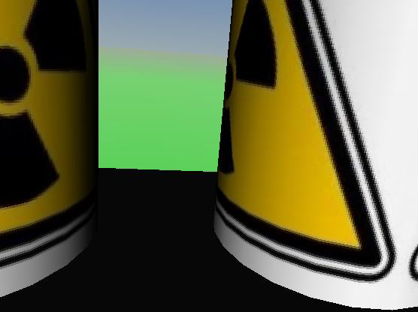
SIMULATION OF THE ARM
PRIMARY VIEW
END-EFFECTOR VIEW

Slide 13
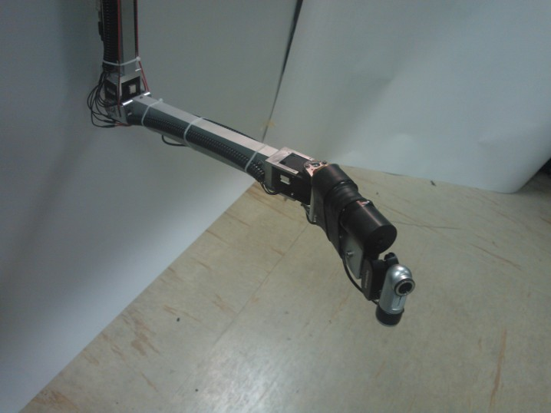
RadIBot
RADIATION INSPECTION ROBOT
2 REVOLUTE JOINTS
END EFFECTOR
RADIATION SENSOR
COMPACT CAMERA

Slide 14
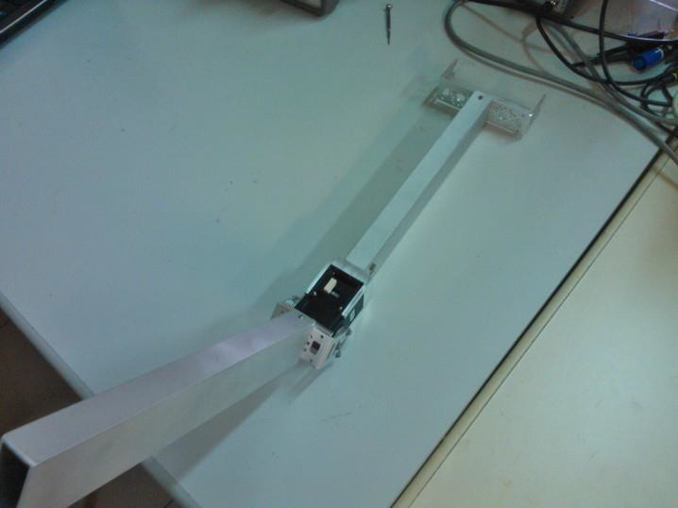
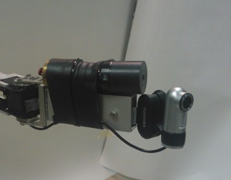
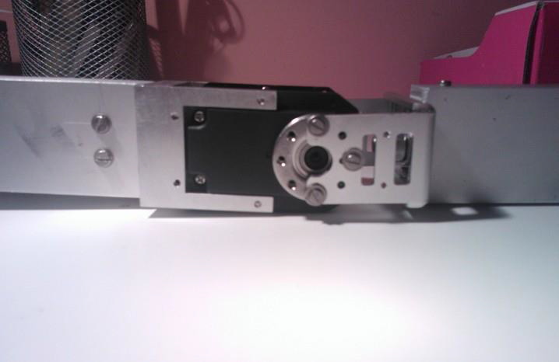
RadIBot
RADIATION INSPECTION ROBOT
MECHANICAL REALIZATION
USE A CRANE FOR VERTICAL MOVEMENT
SUPPORT CLAMP FOR THE MOTORS
REVOLUTE JOINTS
END EFFECTOR

Slide 15
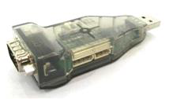
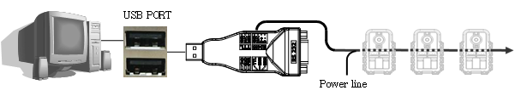
RadIBot
RADIATION INSPECTION ROBOT
COMMUNICATION
USB2DYNAMIXEL
USB TO RS485/232 OR TTL
TYPICAL MASTER-SLAVE CONFIGURATION

Slide 16
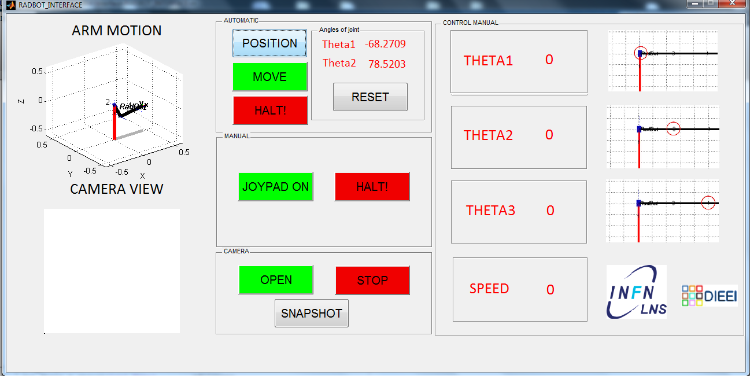
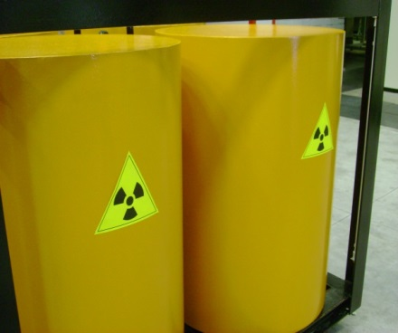
RadIBot USERS INTERFACE

Slide 17
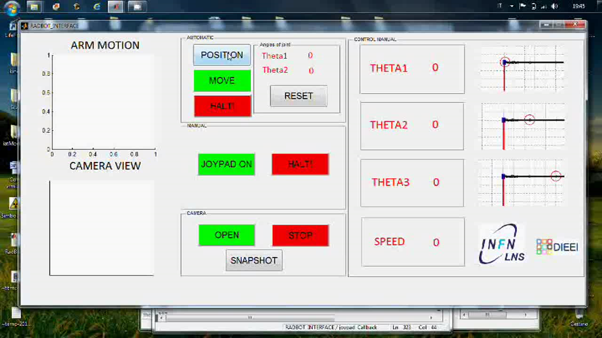
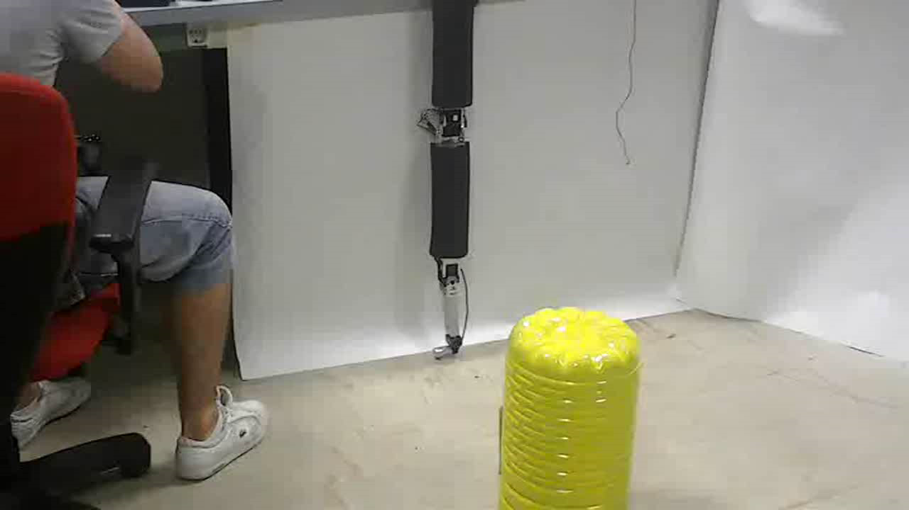
INTERFACE
REAL MANIPULATOR

Slide 18
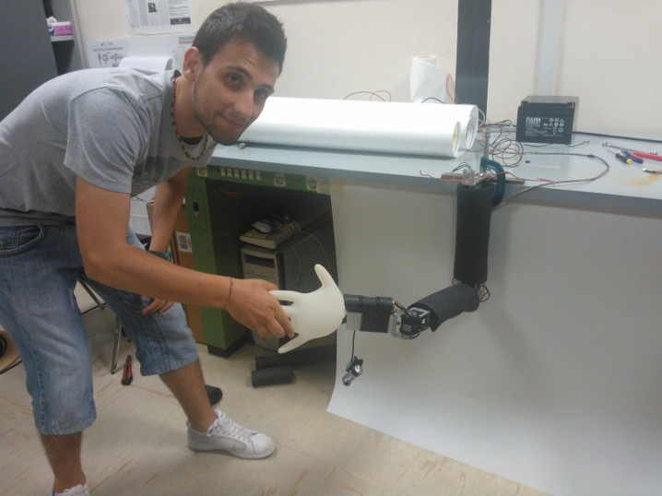
THANK YOU!

